Slide 1
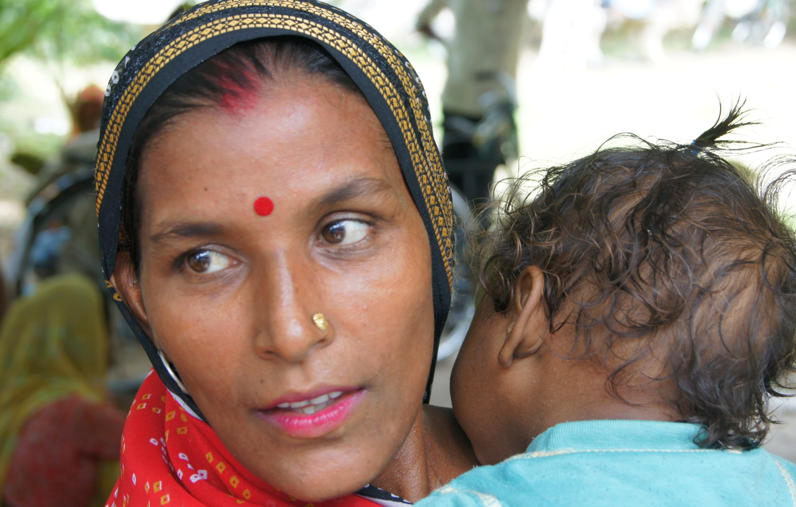
District decision-making for health in low-income settings:
Data-Informed Platform For Health a feasibility study from India, Nigeria and Ethiopia
Dr. Bilal Avan
London School of Hygiene and Tropical Medicine
1

Slide 2

Outline
Data Informed Platform for Health
Conduct of feasibility study
Lessons learnt from the feasibility studies
Next steps
2

Slide 3
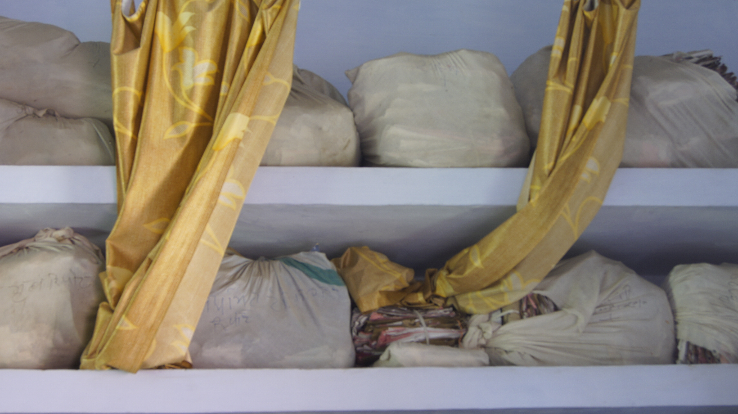

Background
Low-resource settings often have limited use of local data for health system planning and decision-making for MNCH services.
Key challenges
    Data quality
    Professional expertise
    Information-system infrastructure
    Robustness of technology
    Culture of evidence-based decision-making
    Health system responsiveness
  One of the possible solution: Data Informed Platform for Health
3

Slide 4
Generic Structure: Data Informed Platform for Health
Level II
Level I
Primary goal
Use of data for appraisal and comparison of programmes and initiatives
Use of local data for decision-making and priority setting in the local health administration
Data Informed Platform for Health
Data informed area for health (inputs & processes)
Data informed area for health (inputs & processes)
Data informed area for health (inputs & processes)
Level I: Primary geographical unit e.g. districts
Level II: Secondary geographical unit e.g. province, state, region or zone
4

Slide 5
Data Informed Platform for Health
  District as a unit of implementation
  Bringing together diverse public sector services influencing MNCH health
  Role of private sector and NGOs
  District-level databases, potentially linked at regional or federal level
  Implementation research challenge
5

Slide 6
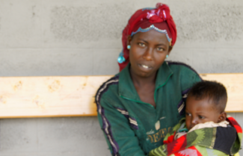
DIPH feasibility study:
India, Ethiopia and Nigeria
Overall aim
To determine whether DIPH approach is technically feasible to implement
Focus: MNH related services offered by public health system and key organisations
6

Slide 7

Feasibility study
TELOS framework
Greek philosophy of teleology: the study of the nature or intentions of a plan or object.
The concept is used in business and management to assess the feasibility of a new service, programme or initiative.
Five dimensions of feasibility research:
  Technology and Systems,
  Economic,
  Legal and Political,
  Operational, and
  Scheduling feasibility.
7

Slide 8





TELOS framework: nature of inquiry
 | Technology and System Feasibility | Do stakeholders have the expertise needed? Are additional resources needed in the health system including infrastructure, skills-sets or job aids? Is the health system ready in terms of the technology required?
 | Economic Feasibility | Do the resources needed exist? Will the proposed health service or initiative lead to better use of resources to improve health outcomes, when compared with other options?
 | Legal and Political Feasibility | Are rules and regulations in place to enable stakeholders to support the new service or initiative? Does the essential political will exist? Is there a legal framework to engage with the private sector or other key service providers?
 | Operational Feasibility | Do existing health system procedures and protocols support the new service or initiative? How will key collaborators be involved?
 | Schedule Feasibility | What are the prerequisites before the new service or initiative can begin? Is the service or initiative likely to be developed in time to be useful to the health system?
8

Slide 9
Methodology
Context: India, Ethiopia and Nigeria
Collaborative effort with respective MoHs
Selection of study districts
Data collection:
  In-depth field visit
  Key informant interviews
  Service-delivery staff interviews
  Record and document review
The readiness to implement DIPH is described on the basis of the relative status of the country according to the feasibility framework
9

Slide 10
Summary of findings
Components | Specific inquiries considered | India | Ethiopia | Nigeria
Technology and Systems | Do stakeholders have the necessary background expertise needed for DIPH? Health system readiness in terms of necessary technology required? | +++ | + | -
Economic | Do the resources needed for the DIPH exist? | +++ | + | +
Legal and Political | Are the necessary rules and regulations in place to enable the stakeholders to support the new health system service or new initiative? Does the essential political-will exist to support the DIPH? | +++ | ++ | +
Operational | Do the existing procedures and protocol of health system support the DIPH? | +++ | + | ++
Schedule | What prerequisites need to be in place prior to the execution of the DIPH? | +++ | ++ | +
+++ = sufficient, ++ = basic minimum, + = limited, + = negligible, - = nil
10

Slide 11
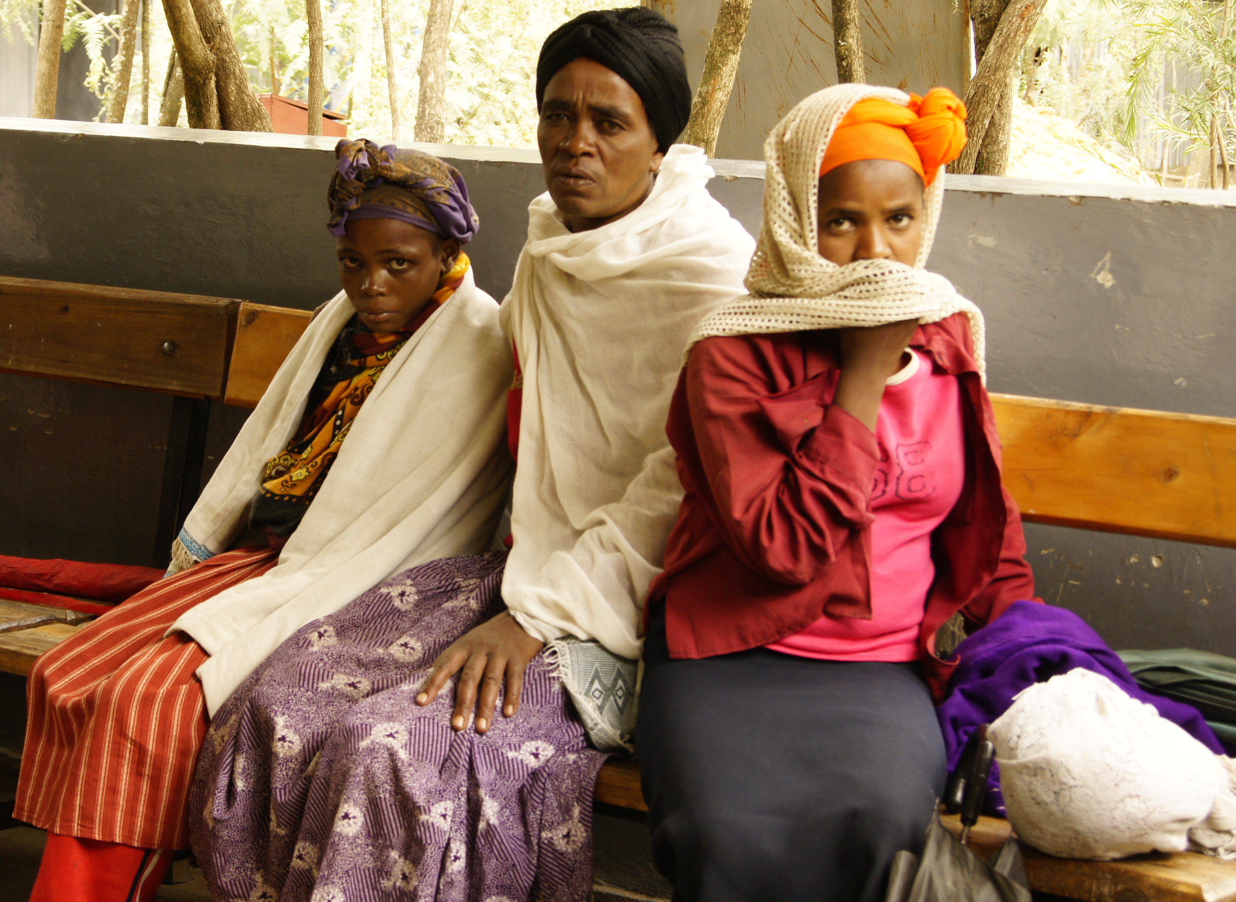
Findings and lessons learnt
Potential challenges
Utility perspective for the health systems
Embedding in the health system
Private sector placement
Technical capacity building
Standardisation of decision-making processes
Network architecture across different levels
Organisational barriers among public, NGO and private sector
Data harmonisation
Performance evaluation
Opportunities - related ongoing initiatives in the country
M-health
Score cards on performances
11

Slide 12

Next steps
Pilot study
  To build upon the evidence of decision-making at the district level
  Strategies to support readiness and acceptance of private sector
  Streamlining the district level leadership and health system governance
  Scaling up of DIPH in the context of key MNCH interventions and innovations
12

Slide 13

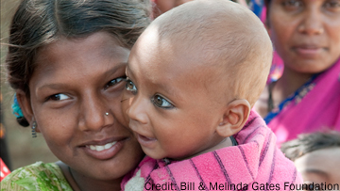

Slide 14
A systematic literature review:
To explore decision-making processes that support the use of health data at district level in low- and middle-income countries
Deepthi Wickremasinghe, Iram Hashmi Ejaz,
Joanna Schellenberg, Bilal Iqbal Avan
Improving health worldwide
ideas.lshtm.ac.uk
14
Notes:
One aspect of the research we’ve done is a systematic literature review to explore decision-making processes that support the use of health data at district level in low- and middle-income countries.

Slide 15
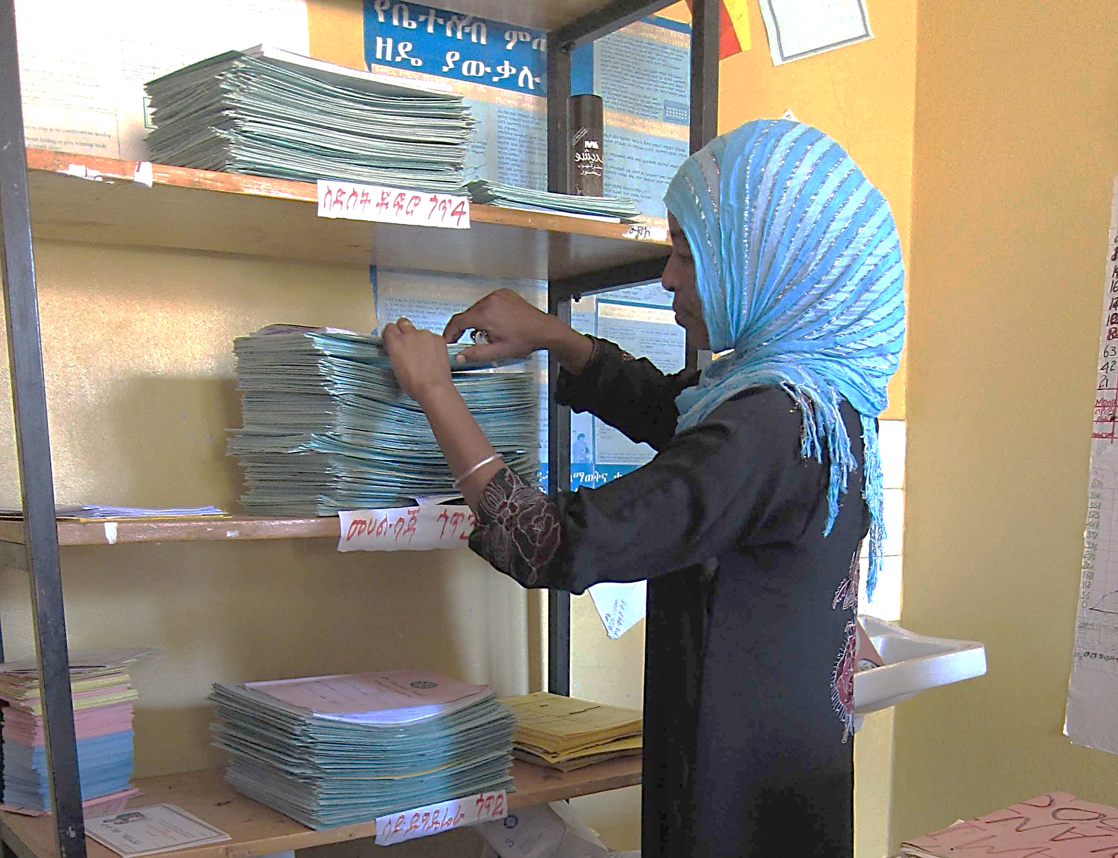
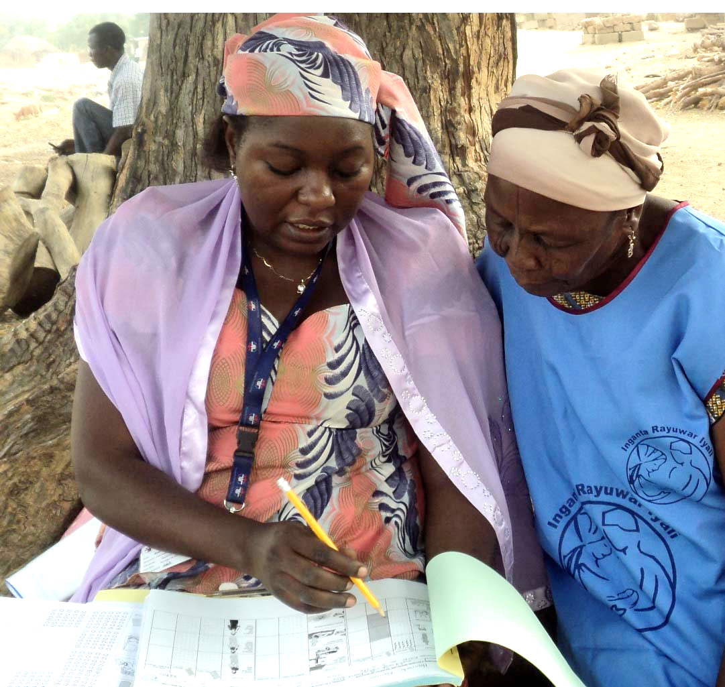
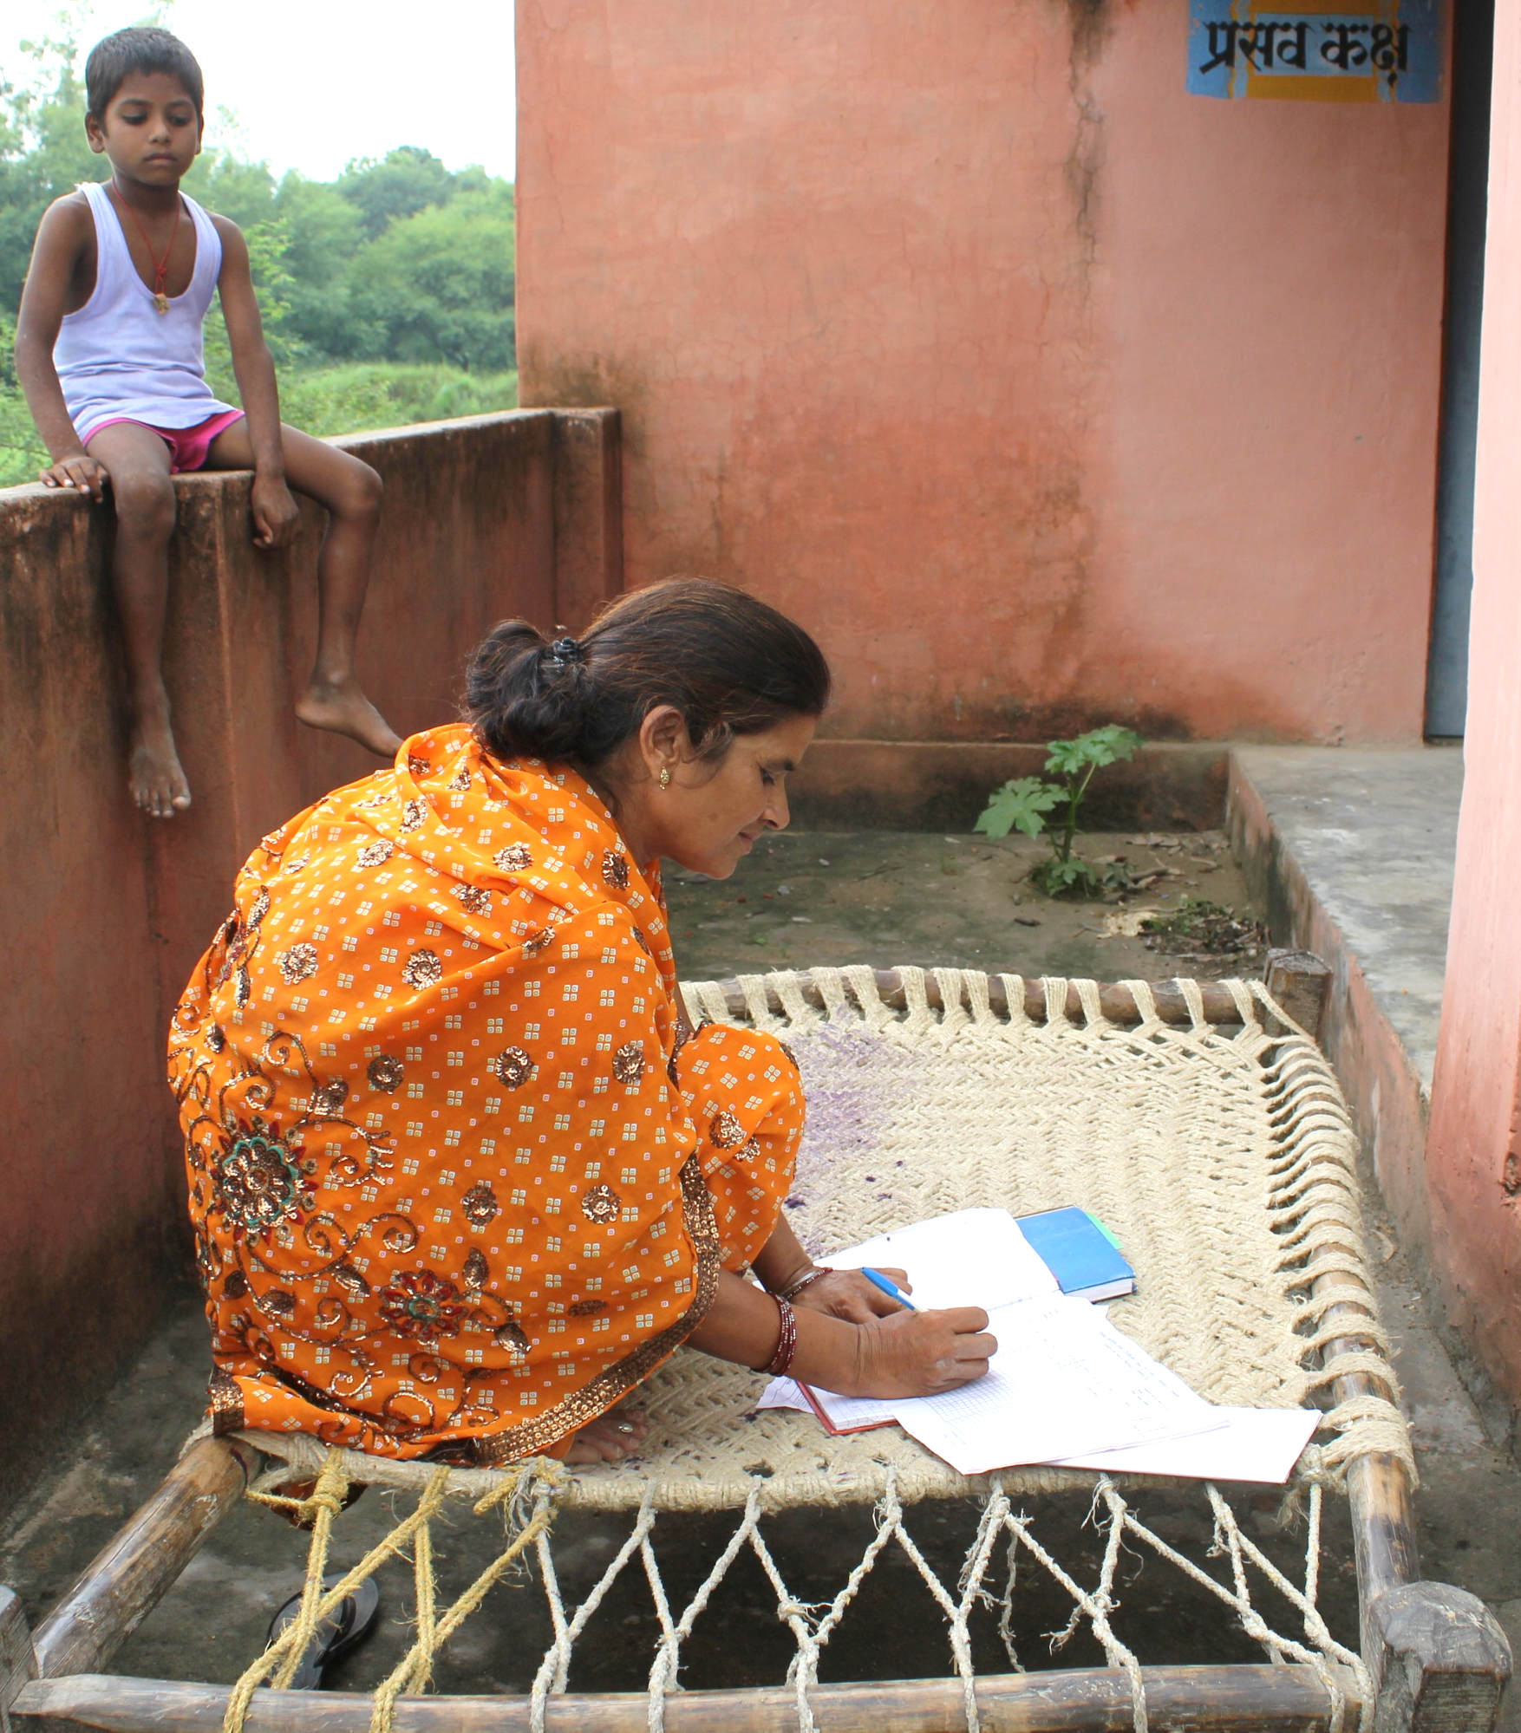
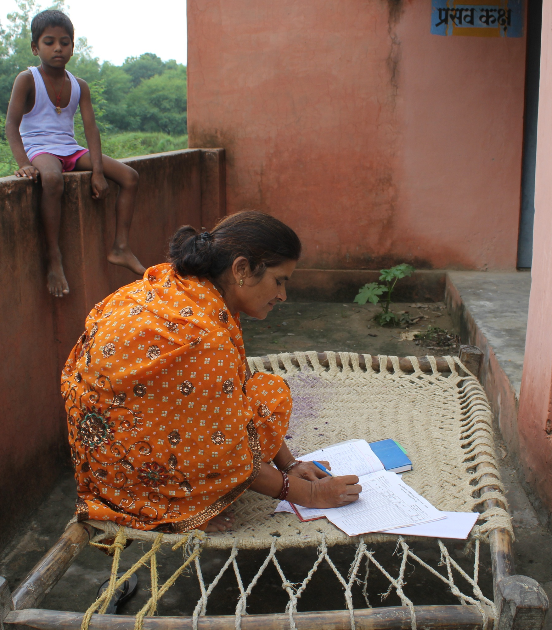
Are local health data used in decision-making?
1
2
2
Record keeping in a health post in Ethiopia - Neil Spicer
Data collection in Gombe State, Nigeria - Society for Family Health
3. Woman adding data to a health form in Uttar Pradesh ,India – Meenakshi Gautham
3
15
Woman adding data to a health form in Uttar Pradesh, India
Woman adding data to a health form in Uttar Pradesh, India
Notes:
Large amounts of data are generated for Health Management Information Systems in low- and middle-income countries, but there is little evidence that locally generated data are systematically used for decision making at district level.

Slide 16
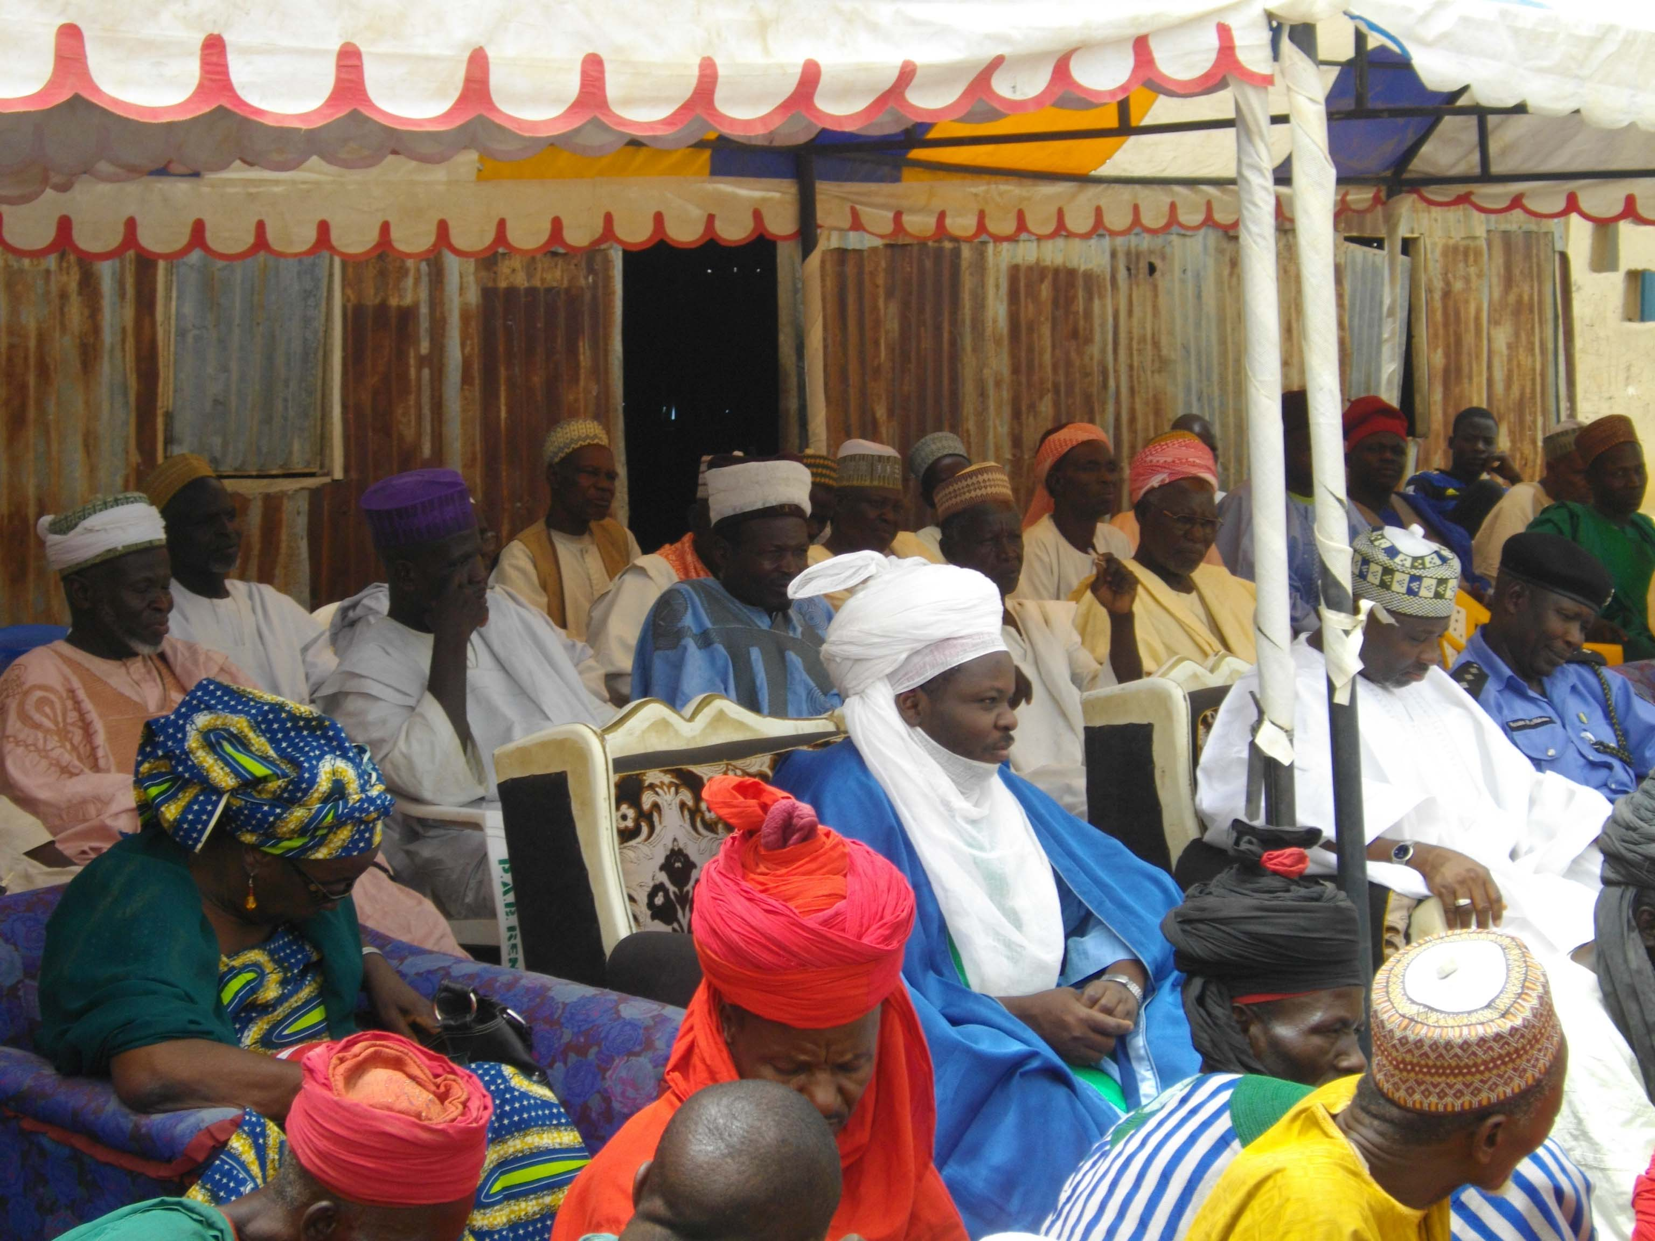
What processes do district decision makers use…
to make health decisions?
Community meeting in Gombe State, Nigeria – Society for Family Health
16
Notes:
We wanted to find existing literature to inform our understanding about how district administrators make decisions and reach consensus; and to identify the best methods of decision-making, in order to develop a decision-making process for use at district level. We are developing this process as part of the data informed platform for health framework that Bilal has just spoken about.

Slide 17
Flow diagram of the systematic review process
  Protocol and Eligibility criteria created
Study identification
6108 peer-reviewed records identified
173 grey literature records identified
6281 titles and abstracts
3819 duplicates removed
First
screening
2462 titles & abstracts screened for eligibility
2305 records excluded
157 full texts
3 full texts not available
Second screening
154 full texts read
140 full texts excluded
14 full texts included for analysis
17
Notes:
We conducted a systematic literature review, following PRISMA guidelines. And developed a search strategy which we used to search 14 key databases of peer reviewed and grey literature...Here you see the three different steps – marked by the green boxes on the left-hand side – that we used to sift through the resources that the search produced, so that in our analysis we could focus on those which were relevant. At each step, the resources were reviewed independently by 2 reviewers. We compared results and resolved any differences of opinion to reach consensus on which texts should be included in the next step and ultimately in the analysis….
We then assessed the quality of the evidence in the 14 relevant resources using a set of 15 criteria adapted from various existing quality assessment forms for qualitative research. This helped ensure our findings were reliable and robust. We assessed whether the evidence in each resources was of high, acceptable or low quality. Ten were of high quality and 4 of acceptable quality, so all the resources were included in our analysis.

Slide 18









What we found:
Examples of generic decision-making processes at district level from
Cambodia
Ghana
India
Nigeria
Malawi
Mozambique
Philippines
Tanzania
Zambia
Flags from Science Kids ©
18
Notes:
These are the countries on which the studies in our analysis were based. 3 papers related to the same case study in Tanzania. And 1 paper included case studies from two countries; Ghana and Mozambique…
We developed a data extraction table to guide our analysis. Nearly all the resources we looked at described case studies (there was also 1 realist evaluation and 1 situation analysis).

Slide 19
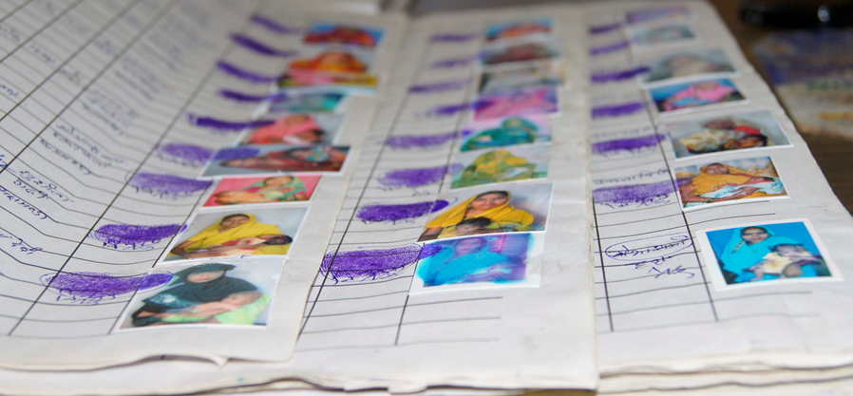
What we found:
All the decision–making processes included two steps
Prioritise the health issues to be addressed
2. Develop an action plan
Maternal and newborn health register in Uttar Pradesh, India – Bilal Iqbal Avan
19
Notes:
All the decision-making processes included two steps…..[CLICK] Prioritisation of health issues to be addressed, and [CLICK] the development of an action plan…
Some processes also included other steps, for instance: steps for review, approval and implementation… One third of the processes included a step for monitoring and evaluating the actions taken….
None of the studies mentioned any formative work that had been done to develop and test the decision-making process described. And none mentioned any steps to evaluate the effectiveness of the decision-making process.

Slide 20

What we found:
Types of data used for decision-making
Health Management Information Systems data (HMIS)
Facility records
Document reviews
Other sources of data…
Health facility data in Ethiopia – Bilal Iqbal Avan
20
Notes:
All the decision-making processes we looked at used locally-derived data. [CLICK] About two thirds used HMIS data…but most also used data from elsewhere, including…[CLICK] facility records….[CLICK] document reviews…[CLICK] and information from other sources, such as: surveys, the demographic surveillance system – DSS, observation, discussion and experiential information (gathered from visits decision makers made to see the reality for themselves), and information gained from expert opinion.

Slide 21



What we found:
Challenges to decision-making processes
Availability of health and health facility data of good quality
Human dynamics within a formal, data-based decision-making process
Decisions compromised by financial
constraints
All icons from The Noun Project (Clipboard by Jerad Maplethorpe; Coins by Musket)
21
Notes:
Challenges to these processes fell into 3 broad categories: [CLICK] Health data that are timely, accurate and relevant – usually data are collated for national HMIS reports; they are passed on for use in reports at higher levels of the health system and they in turn get handed up to national level, but in the process the data lose their granularity and may be out of date by the time they are fed back down to district level…
[CLICK] The capacity of district health officers often needs to be developed so that they have the knowledge and skills to use data…
[CLICK] In addition, in most cases, district decision-makers had no control over the health budget and resources to carry through on their decisions, because there was only limited health system decentralisation that did not allow for district-level budget distribution.

Slide 22
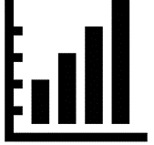


Interpretation: Three good practices for a decision-making process
Relevant and good quality data are pre-requisite
A structured process, including steps to help build consensus
A well-defined role for the community
Icons from The Noun Project
(Graph by Simple Icons; Consensus by Krisada; People by Tuk Tuk Design)
22
Notes:
Although the evidence was limited, we found examples of good practice and processes that used that HMIS for effective shared decision-making at district level. From our findings we identified three key features of a decision-making process….
[CLICK] That relevant and good quality data are a pre-requisite for evidence-based decision-making taking local needs and context into account…
[CLICK] That a structured decision-making process should include steps that will help decision makers build consensus, encourage discussion and develop a greater understanding of the issues, and help foster buy-in and ownership of the final decision…
[CLICK] And thirdly, that giving the community a well-defined role in the decision-making process, helps build trust, and strengthen transparency and accountability.

Slide 23

Recommendation…
Wider adoption of a decision-making process would be enhanced by standardisation and pre-testing in diverse settings
Icon from The Noun Project (Bubble comparison by Meaghan Hendricks)
23
Notes:
To these key features we would also add a recommendation…[CLICK] That a standardised decision-making process is adopted… Although local socio-political priorities within a district will play a part in interpreting and applying the process, and may require adaptations, the technical aspects of a standardised process are likely to be broadly the same across the sub-national level. A well-defined protocol would help specify and implement that process, so that it can be used repeatedly and achieve operational consistency when used in the same setting.
You might wonder what this diagram has to do with a standardised decision-making process: you’ll notice that all the shapes are circles – a circle represents a standardised process. But these circles are different sizes and have different tonal values to depict and ways in which that standardised process is applied and adapted locally.
Next, we will hear about the decision-making structure and the use of data for planning and resource allocation in districts of two states, in India; as well as the volume and types of health data collected at district level in India and Ethiopia, and data sharing flow between public and private health systems in both countries.

Slide 24

Content analysis of district level health data and inter-sectoral linkages in India and Ethiopia
Dr. Della Berhanu
London School of Hygiene and Tropical Medicine
Dr. Sanghita Bhattacharyya
Public Health Foundation of India
24

Slide 25
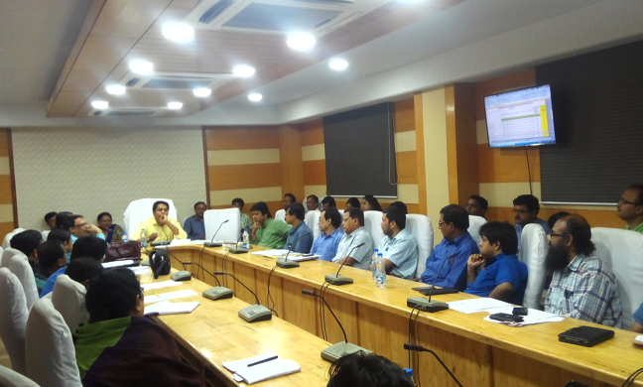
Current district decision-making process
25

Slide 26
District decision-making: India
  Objective:
  To explore district decision-making structure
  To understand use of data for planning and resource allocation
  Study Area:
  North and South 24 Parganas districts in West Bengal State
Methods:
In-depth interviews with 28 representatives of district decision-making body in India.
Observation of 4 district decision-making meetings in India
26

Slide 27
District decision-making: Structure
Who?
What?
When?
Representative?
“District Health Society is a type of district level convergence meeting, where you get all the government officials… So the meeting can determine policy for different health activities like construction, health programmes, funding, budgeting, planning, analysing current health situation of district …” [Health department rep.]
As per guideline our department should participate in District Health Society meetings but practically they are not aware of importance, and the health department is also not taking initiative to motivate our participation … Our role is ill-defined…”
[Non-health department rep.]
27
Notes:
Who? District Health Society (DHS) is decision making body comprising of health and non health department.
What? Key functions of DHS includes allocation of funds, review/ ratification of district health plan.
When? DHS meets every 2-3 months.
Representative? The Non- health departments are not adequately represented.

Slide 28
District decision-making: Process
How?
However…
“We have to go by the priorities set by Government of India state government. Other suggestions from local political or community can be considered and discussed depending upon its usefulness…”
[Health department rep.]
“Funds are not released based on priorities set by us, rather priorities are set based on availability of funds”
[Health department rep.]
“District Health Society only plans for health department.… mostly health department decisions are prioritised at the meeting”
[Non-health department rep.]
28
Notes:
How?
The planning adopts a top-down approach and the priority changes as per state health agenda.
Community and sub- district bodies have the flexibility to submit proposal to DHS;
however, the final decision depends on agenda of the state health programs.

Slide 29
District decision-making: Observation on data use
For:
Planning?
Fund allocation?
“Enormous data is being collected, but remain unutilised due to lack of time and inadequate manpower. Data is a very interesting tool if we use it in a proper way”
[Health department rep.]
“Yes data is useful for planning. E.g Mission director when visited this hospital found bed occupancy rate at 130%. Then proposal of increasing beds in maternity ward from 85 to 120 was developed and put in District Health Society meeting”
[Health department rep.]
“There is no such link between funding and data, in my personal opinion funding is very specific (state guideline) and never linked with data …”
[Non-health department rep.]
29
Notes:
Data use? Observation of DHS meetings showed
(Planning) Though large volume of data is generated at the grass-root level, it is not used for planning & decision making at DHS.
There is rarely any presentation and discussion of health indicators
(Fund allocation) There is no allocation of funds to different program heads based on data.

Slide 30
Needs identified by stakeholders
District Health Society members identified the following three key needs in terms of current decision-making process:
Improve coordination between different departments for knowledge interchange
Increase use of data to identify problems and use for planning.
Develop a structured decision-making tool for District Health Society meetings.
30

Slide 31
Content analysis of district level health data and inter-sectoral linkages in India and Ethiopia
31

Slide 32
Outline
  Background
  Method
  Findings from India and Ethiopia
  Summary
32

Slide 33
Background
  Why conduct a content analysis of data?
  To inform us on data:
    Availability
    Duplication
    Filtration from one level to the next
    Quality
  Shared data can provide comprehensive information for local decision-making, aligning health service delivery with the available resources and community health needs
33
Notes:
Within the context of district level decision making-

Slide 34
Background
Indian Health System
Ethiopian Health System
District Hospital
> 30,000
Primary Hospital
60-100,000
Community Health Centre
10,000- 30,000
Health Centre
15-25,000
Primary Health Centre
5000-10,000
Health Post
3-5,000
Sub Centre
>5,000
Community health workers
1,000
34
Notes:
India (middle-income country) and Ethiopia (a low-income country)
Both have a decentralized health systems with different levels having a mandate to use data for planning and decision making
In both public and private sectors play a major role in providing health service delivery
Health data are generate from multiple sources
Here in addition to highlighting the similarities we need to state the differences as well

Slide 35
Objectives
To understand the:
Volume and types of data collected at different health system levels in a district
Data flow and data sharing between public and private health system
35

Slide 36
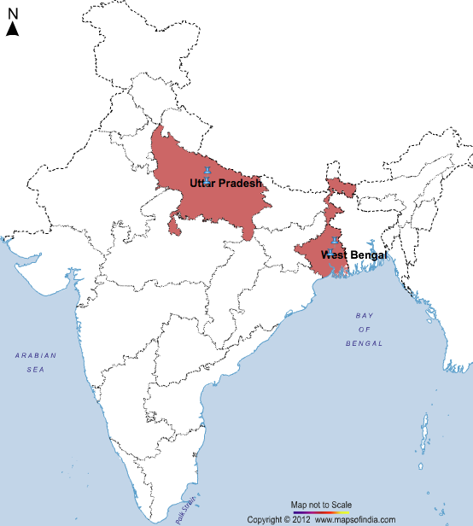
Study areas
  Sitapur and Unnao districts in Uttar Pradesh State
  Dendi district in Oromia region
  Basso district in Amhara region
36

Slide 37
Methods: Data collection
Visited 8 public health facilities in each country
Collected data forms from different public health system levels
Interviewed individuals at the district level to understand data flow and data sharing
37

Slide 38
Methods: Content analysis
Data categorisation:
Used Microsoft Access
Categorised forms by level of completion and reporting frequency
Identified and sorted thematic areas into the six WHO health system categories
Each data element was then categorised into to a thematic area
Content analysis:
To see the type and amount of data available for different health system levels
Further analysis to understand the MCH service delivery data
38
Notes:
Content analysis was time intensive. It took several months to sort through and to ensure consensus we had more than one researcher categorizing data elements

Slide 39
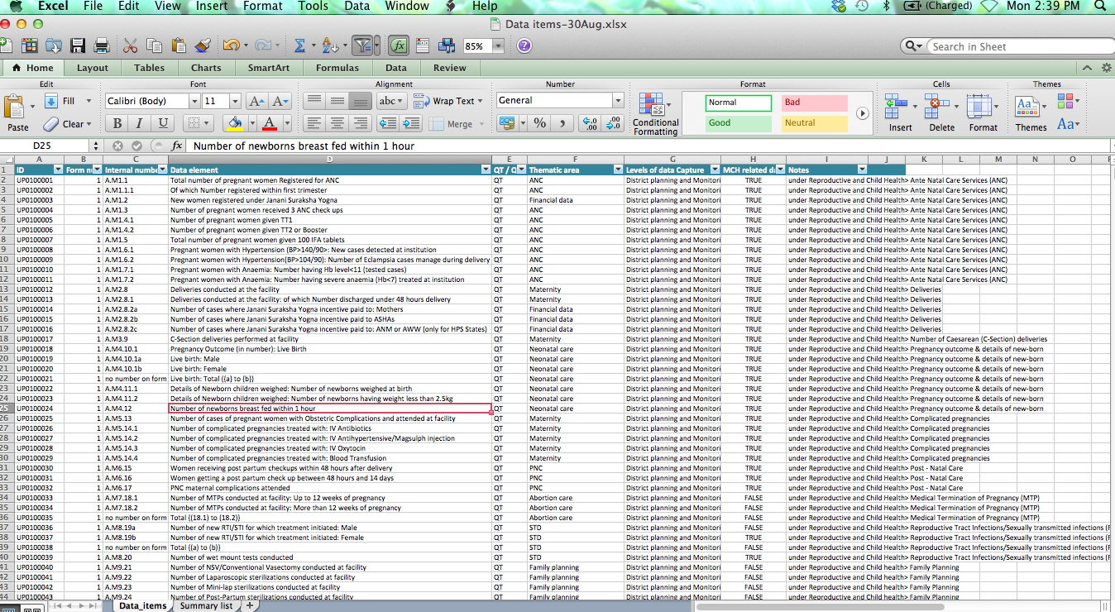
Notes:
Double checking using more than one researcher
This can show you how data are filtered or added as you go from one level to the next
How one data element can come from multiple sources (duplication of data collection)

Slide 40
Methods
Content analysis of data forms
WHO health system categories | Thematic Areas
1. Service delivery | ANC, Delivery, PNC, Newborn care, Immunisation, Nutrition Family planning, Adolescent health Water and sanitation Non-communicable diseases, TB, Malaria, HIV
2. Contextual factors | Infrastructure of facilities, households and villages Demography
3. Medical supplies | Resources/ supplies
4. Workforce | Human resources Training
5. Governance | Management (supervision) Grievance redress
6. Finance | Expenditure Financial incentive Insurance scheme
40
Notes:
According to the WHO the attributes of a health system go beyond service delivery, they include contextual data, medical supplies, workforce, governance, and finance. So in order to make an informed decision at the district level, information across these 6 categories are needed. Hence we wanted to see if the district level forms had data across these categories and such we did a content analysis.

Slide 41
Findings:
Content analysis of district health data and inters-sectoral linkages in India
41

Slide 42
Volume of data available in a district health system
India
42
Notes:
TOTAL forms 207

Slide 43
Types of data available in a district health system
India
43

Slide 44
India
Types of data available at different levels of the district public health system
44

Slide 45
Maternal, neonatal and child health data collected in district public health system
India
*Integrated MCH programme including nutrition, family planning, abortion, sanitation
45

Slide 46
India
Inter-sectoral linkages in health data flow and sharing
Private
(for-profit and not-for-profit)
District Health Society
Non-health departments & ministries
District level -
District hospital & district NHM programme management unit
State
Health directorate and NHM programme management unit
Centre
Ministry of Health & Family Welfare (Monitoring and evaluation division)
Sub-district level –
Primary & community health centre
Village health, sanitation and nutrition committees
Community and village level –
Community health worker & health sub-centre
Formal data sharing
Informal data sharing
46

Slide 47
Findings:
Content analysis of district health data and inters-sectoral linkages in Ethiopia
47

Slide 48
Volume of data available in a district health system
Ethiopia
N= 13 forms
48
Notes:
TOTAL forms 207

Slide 49
Ethiopia
Types of data available in a district health system
49

Slide 50
Ethiopia
Types of data available at different levels of the district public health system
.
50

Slide 51
Ethiopia
Maternal, neonatal and child health data collected in district public health system
*Integrated MCH programme including nutrition, family planning, abortion, sanitation
51

Slide 52
Ethiopia
Inter-sectoral linkages in health data flow and sharing
District Cabinet
District level
District Health Office
Private
(not-for-profit)
Sub-district level
Health centre
Private
(for-profit)
Formal data sharing
Community and village level
Health Post (Health extension workers)
Informal data sharing
Kebele administration
Command post
52

Slide 53
Summary
Content
Information is available on all 6 categories in both countries
In both countries a majority of the data is on service delivery
Parsimony vs Diversity of forms (13 vs 210 forms)
There is filtering of data from the community up
Unlike in India, in Ethiopia district level collects additional data
More data on neonates collected in India
Technique
A new way of looking at the available district level data
It provides an objective and quantifiable perceptive on what exits
Allows optimisation of data utility
53
Notes:
More duplication in the 210 fors

Slide 54
This study was undertaken under the Informed DEcisions for Action (IDEAS) project, London School of Hygiene and Tropical Medicine
Research team- India
Dr. Sanghita Bhattacharyya, Dr. Aradhana Srivastava, Dr. Bhusan Girase,
Ms. Mayukhmala Guha, Ms. Anns Issac.
Research Team- Ethiopia
Dr. Della Berhanu, Mr. Nolawi Taddesse and Seifu Taddesse
Research supervised by
Dr. Bilal I Avan
Principal Investigator
Dr. Joanna Schellenberg
54

Slide 55
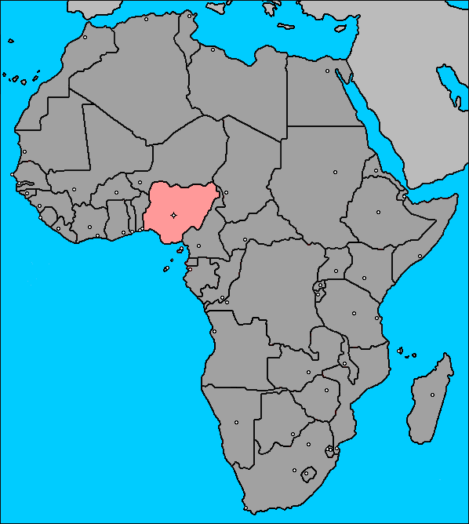
Use of health data for decisions at the district level on maternal and newborn health in Northeast Nigeria
Dr. Nasir Umar
London School of Hygiene & Tropical Medicine
Improving health worldwide
ideas.lshtm.ac.uk
55

Slide 56
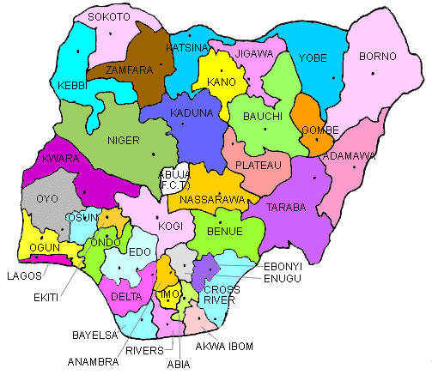
Background: Three-tier system of government
Federal:
Set strategic decisions or policy goals; resource mobilisation & distribution to attain set goals
State:
Oversee the adoption or adaption of national health policies at the state and LGAs
LGAs:
Decisions on the provision of primary health care
56

Slide 57
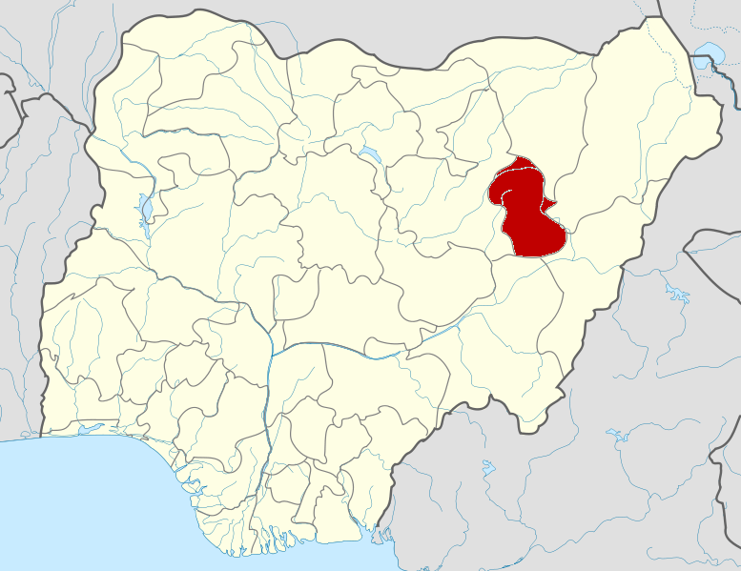
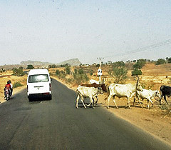
Study setting: Gombe state
Located in the North-East region of Nigeria; estimated population of 2.8 million
Multi-ethnic and comprises 11 LGAs
About 75% of the state is rural
57

Slide 58
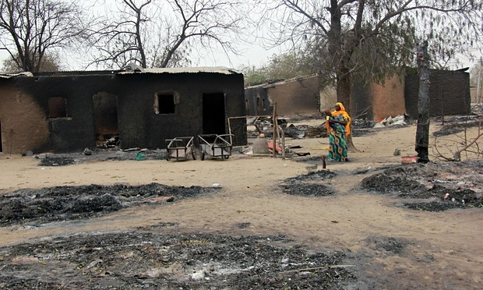
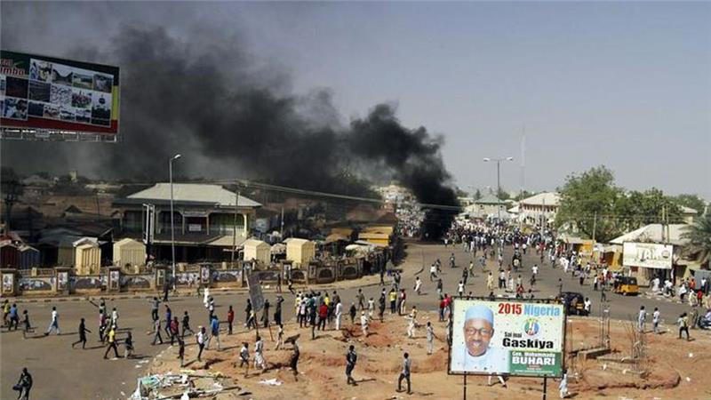
Study setting: Shongom LGA
Estimated population of 151,520
Purposefully selected
58

Slide 59
Methodology: Data collection
In-depth interviews about the generation of maternal & newborn health data and use of data collected to improve maternal & newborn care
Key informants: drawn in collaborations with state ministry of health, state ministry for local government affairs, primary health care department of the LGA
Interviewees: health administrators, decision-makers, health workers
21 of the 30 interviewees approached agreed to participate (June–December 2012, follow up May –June 2013
59

Slide 60
Methods: Data analysis framework
Improved health decisions
Improved accountability
Information availability
Data collection and analysis
Decision-making process
Information use
Data demand
60

Slide 61
Findings: Data collection, analysis & health information availability for MNH
Tertiary health care
DPRS Federal Ministry of Health
Federal level
State level
DPRS SMOH
Department of Primary Health Care SMOH
Programme officers SMOH
Secondary health care
Director/ Coordinator Primary Health Care
Local government level
Primary health care
Monitoring & Evaluation Officer
Programme officers
DPRS: Department of Planning, Research & Statistics
SMOH: State Ministry of Health
61

Slide 62
Findings: Use of health information & data demand for MNH
Director/ Coordinator Primary Health care
Executive Chairman
Secretary
Director/ Coordinator Primary Health care
Deputy Director Primary Health care
Assistant Coordinator Maternal, Newborn and Child Health
Assistant Coordinator Disease Control
Assistant Coordinator Monitoring & Evaluation
Assistant Coordinator Essential Drugs and Supply
Assistant Coordinator Environment, Sanitation and Water Supply
Assistant Coordinator Leprosy Control and Tuberculosis
Malaria Focal Person
Nutrition Officer
Social Mobilisation Officer/ Health Educator
Local Action Committee on AIDS Officer
Disease Surveillance Officer
Local Immunisation Officer
Onchocerciasis Programme Officer
62

Slide 63
General findings
Data collection & analysis
  Limited skills of local government area staff to process and use health information
  Information availability
  Limited access to health information by decision makers
  Information use
  Inappropriate health information supplied to decision makers
  Data demand
  Lack of funds for regular data management activities
  Insufficient organisational support to demand, process and use health information
  Limited interaction between data producers and data users
63

Slide 64

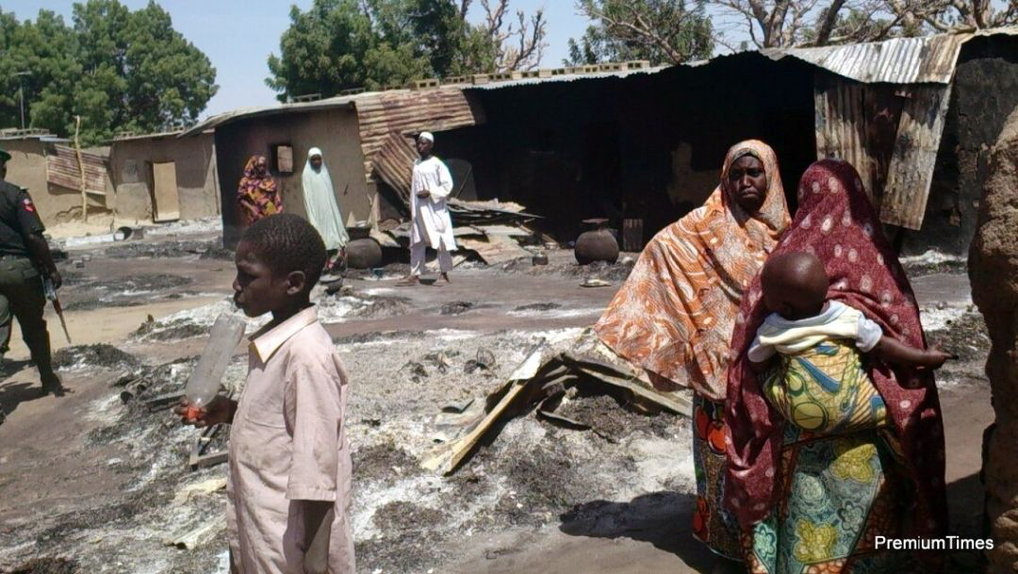
Conclusions
Limited use of health data for decisions to improve maternal & newborn health at the LGA level in Shongom LGA
64

Slide 65

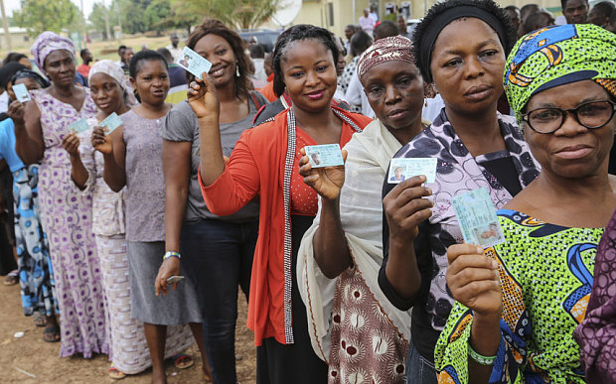

New developments
Primary Health Care Under One Roof
  One management body
  One plan
  One monitoring & evaluation
New national Health Act
  Linked budget earmarked for health
Decentralisation of power/direct funding to LGAs
Improving security
65
64

Slide 66

Thank you very much for listening
Research supervisor
Dr. Bilal I Avan
Principal Investigator
Dr. Joanna Schellenberg
Acknowlegements
HealthHub Nigeria – MLE partner in Nigeria
Gombe state MoH, MLGA
Shongom LGA
66

Slide 67
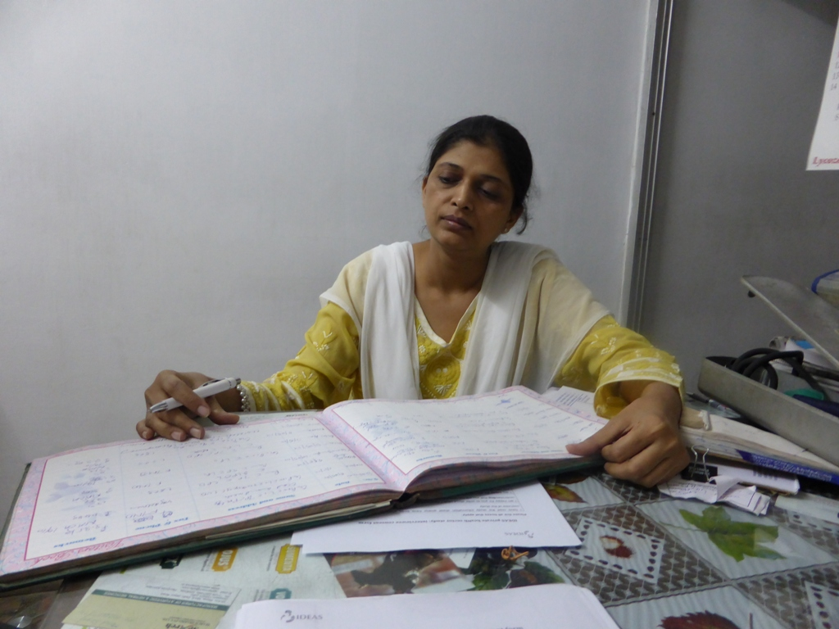
IDEAS private sector study of MNCH data sharing in Uttar Pradesh and
West Bengal, India
Meenakshi Gautham, IDEAS-LSHTM
Neil Spicer, IDEAS-LSHTM
Manish Subharwal, IMPACT
Sanjay Gupta, IMPACT
Nirmala Mishra, PHFI
ideas.lshtm.ac.uk
67
Notes:
This presentation is about our private sector study of data sharing in two districts each in Uttar Pradesh and West Bengal. Sanghita had shown these to you on a map of India earlier. We did this collaboration with Impact – a research organisation and the Public Health Foundation of India. These were part of our larger DIP work which is being implemented in West Bengal currently.

Slide 68
Private sector: important service provider but limited role in public health planning or data sharing
UTTAR PRADESH (UP)
 | Government source | Private Source | Total
Institutional deliveries | 39% | 17.6% | 56.7%
Care seeking for an acute illness (fever, diarrhoea etc) | 5.4% | 92% | 97.4%
Regular treatment for a chronic illness (TB, asthma, hypertension, diabetes) | 15.6% | 43.1% | 58.7%
Source: Annual Health Survey, Uttar Pradesh, 2012-13
68
67
67
Notes:
The background to this study is that the private sector in India plays a major role in health service delivery. District health survey data from UP show that out of 57% institutional deliveries, 18% are in part facilities. It plays an even greater role in ambulatory care for acute illnesses like fevers and diarrhea and for chronic illnesses – both communicable and non communicable. Other smaller studies that a large proportion of child illnesses and also newborn illnesses are treated in the private sector including the informal sector. However in national, state or district level health databases there is very little routine data available on the private sector; neither does one find private sector representation in regular district or state level public health planning forums.

Slide 69
Difficulties in estimation of institutional deliveries without complete data
WEST BENGAL
Institutional deliveries | North 24 Parganas | South 24 Parganas
Total reported institutional deliveries (to total annual estimated deliveries) | 18.7% | 28.9%
Total reported institutional deliveries (to total reported deliveries) | 88.8% | 61.5%
Source: NRHM Factsheet based on district HMIS Apr-Sept 2014
69
Notes:
This is a concrete example that without private sector data the picture of an important public health service like institutional delivery is incomplete. The government is trying very hard to promote institutional deliveries and they need to monitor this increase, but it is hard to accurately estimate institutional deliveries from the state and district health department’s routine data systems. And W. Bengal does not have DHS data, so they have to rely on their health department data. As you can see here, the percentage of institutional deliveries in both our study districts is much less as a percentage of annual estimated deliveries than as a percentage of total reported deliveries. This could be because private sector deliveries are missing from the system.

Slide 70
Study objectives
Determine the composition and role of the private health sector in MNCH services (institutional deliveries, newborn care, immunisation, family planning)
Assess the status of MNCH data sharing by the private sector at the district level
Identify the barriers and enablers to data sharing
UP: Hardoi and Allahabad districts
West Bengal: North and South 24 Parganas
70
Notes:
These two studies were a rapid situational assessment of the private sector. We had 3 broad study objectives – to profile the composition and role of the private sector, assess the current status of MNCH data sharing and the barriers and enablers to these. Study sites were Hardoi and Allbd district in UP and North and South 24 Parganas in W. Bengal. I will be presenting snippets of our findings under each of these objectives.

Slide 71

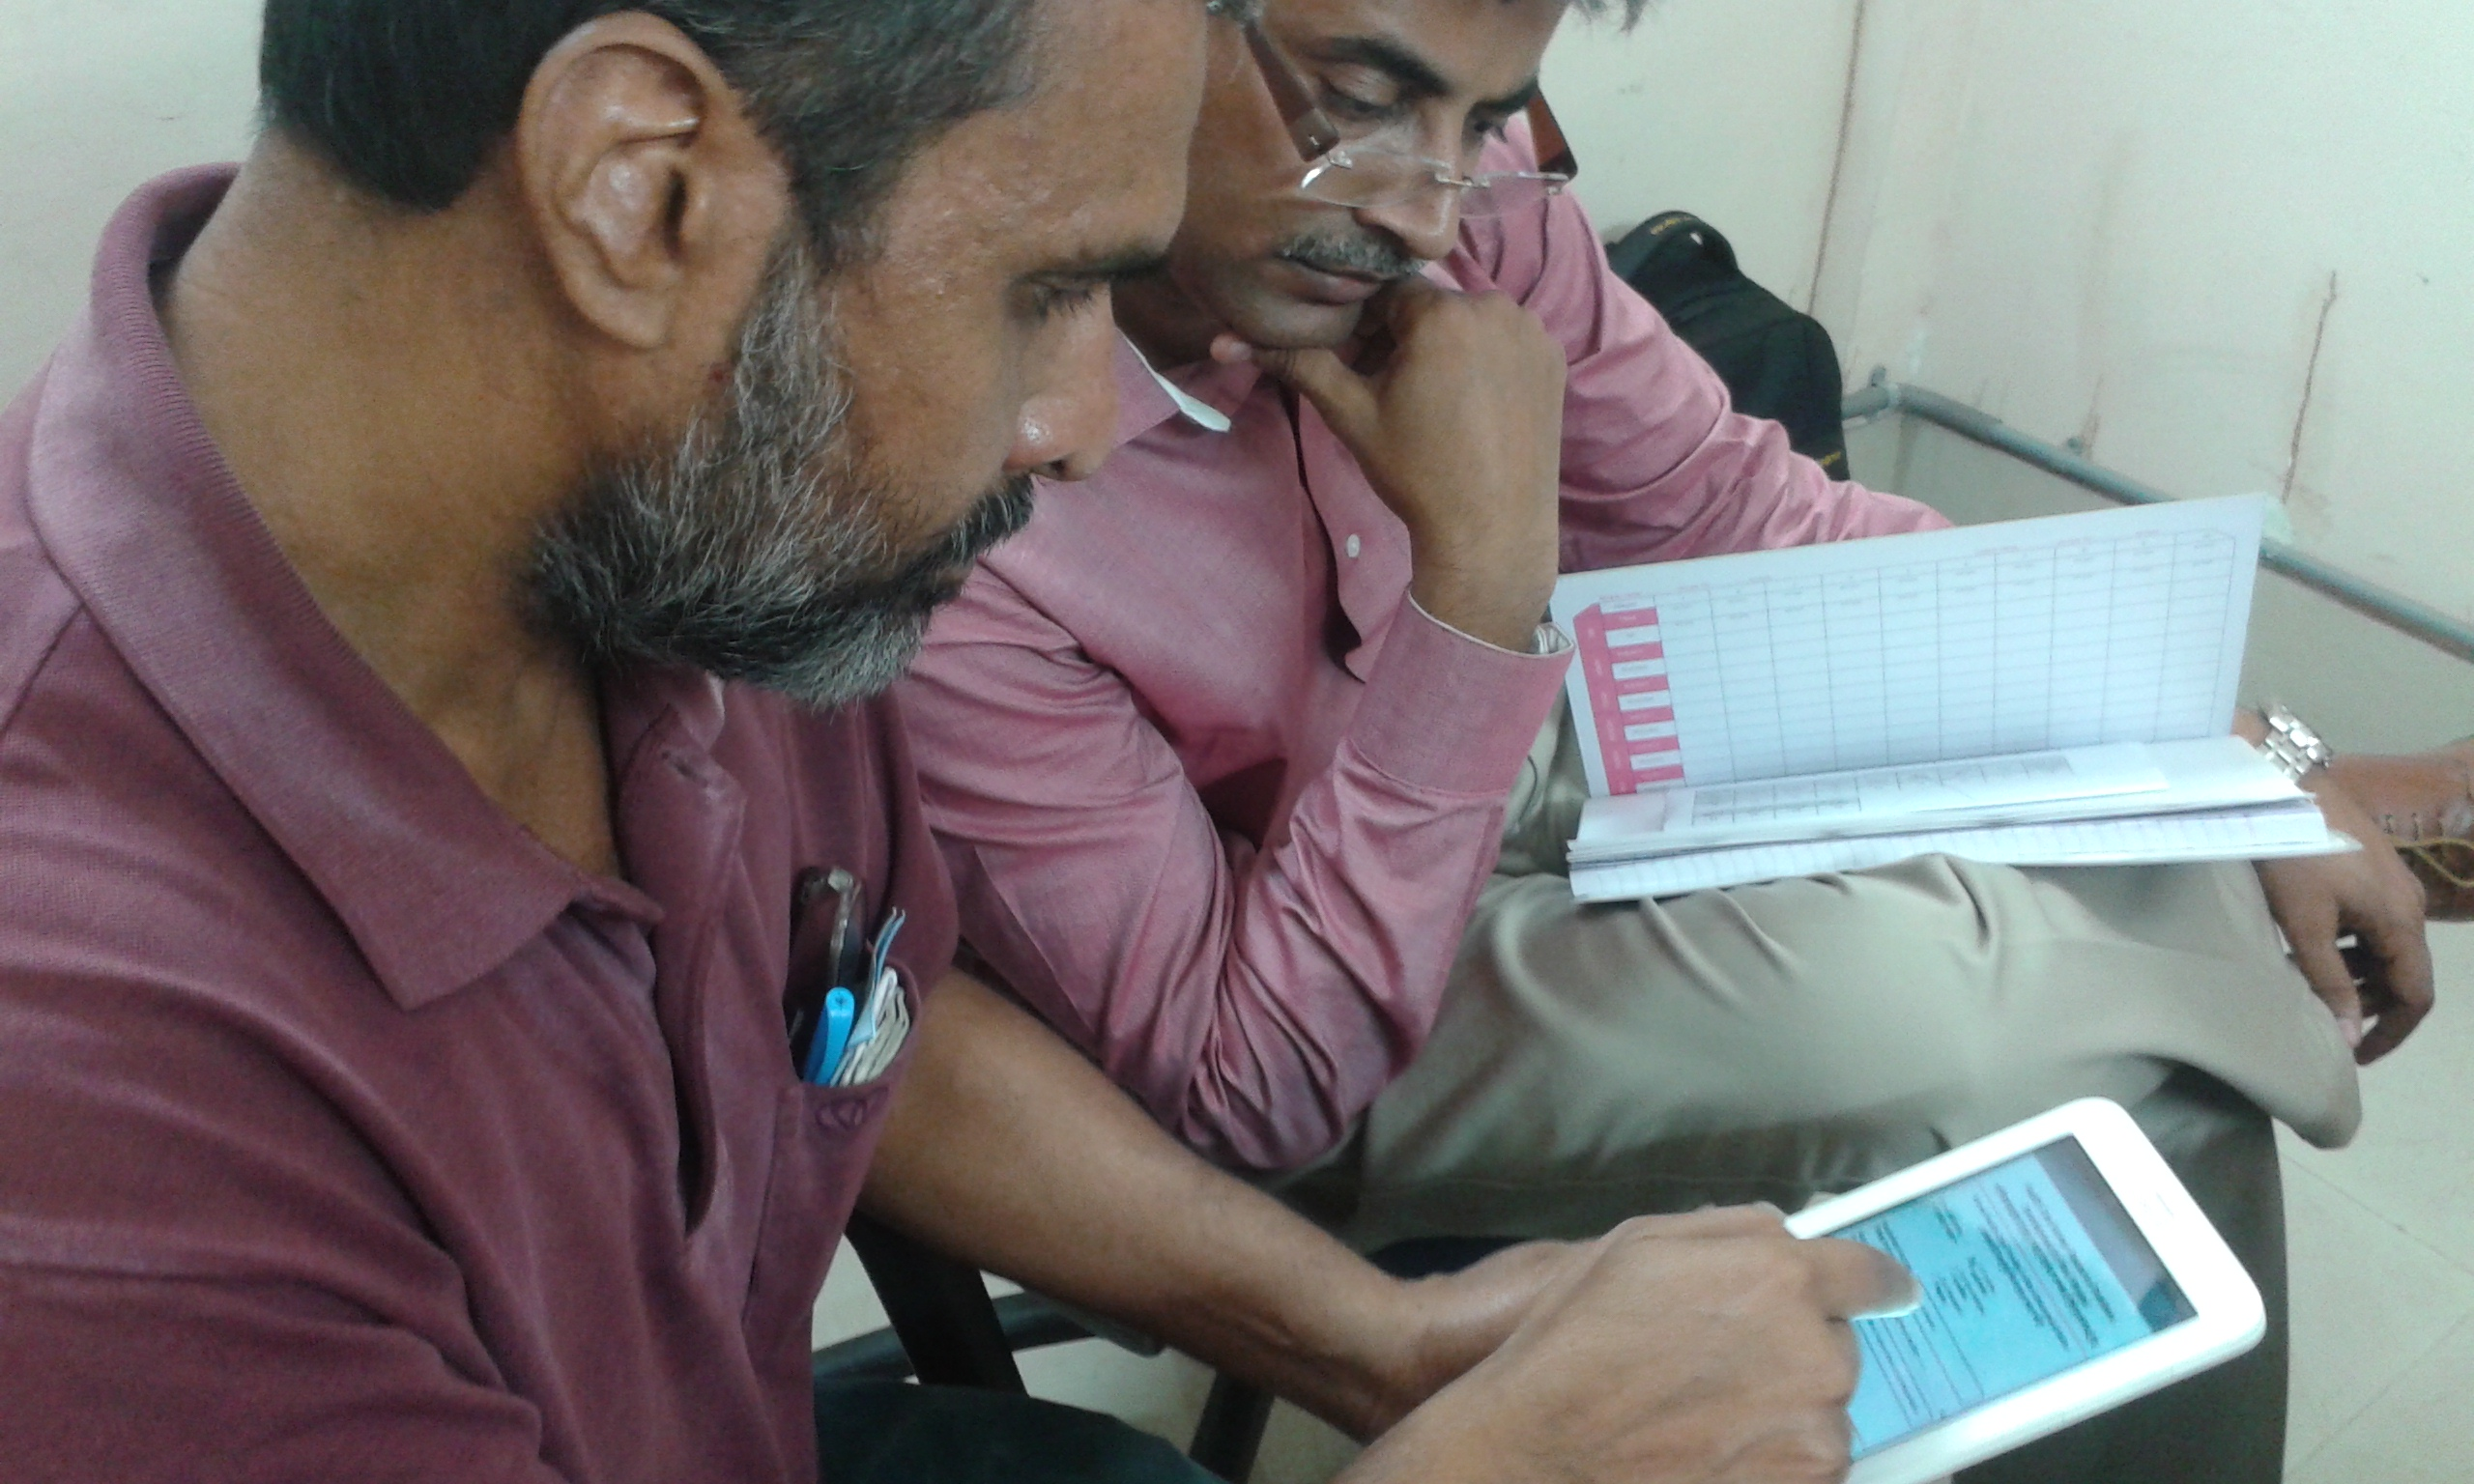
Qualitative study
Key informant Interviews
Uttar Pradesh: 54 interviews
West Bengal: 36 interviews
Secondary data sources:
district level routine data
71
Notes:
We used qualitative methods including a review of records maintained by private facilities and sharing with the district health department and key informant interviews with 54 stakeholders in UP and 54 in W. Bengal, selected across various constituencies including the district and state health departments, private for profit facilities, PPPs in W. Bengal and associations of medical practitioners.

Slide 72
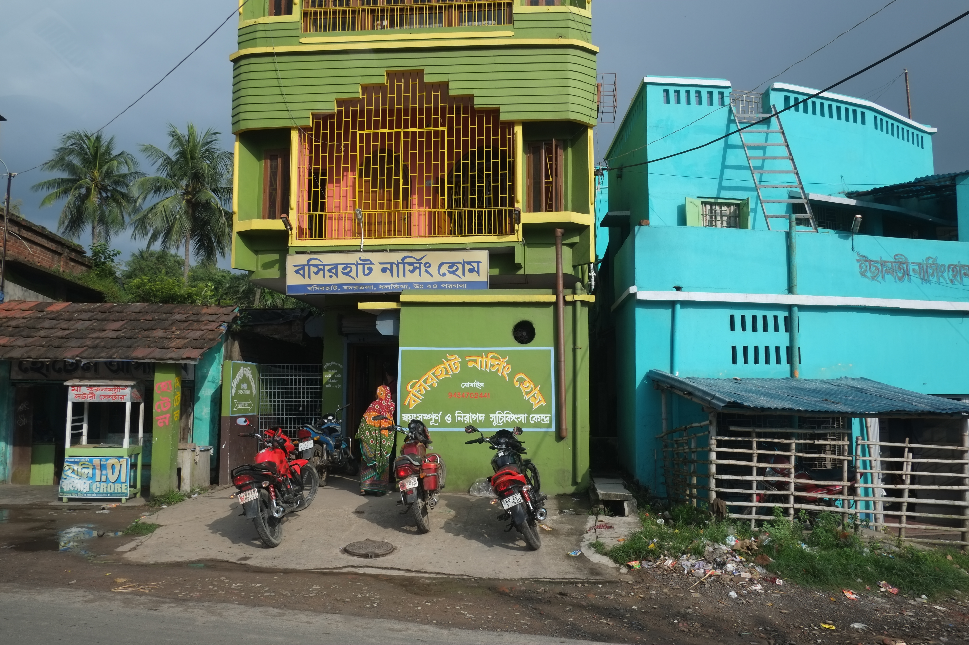
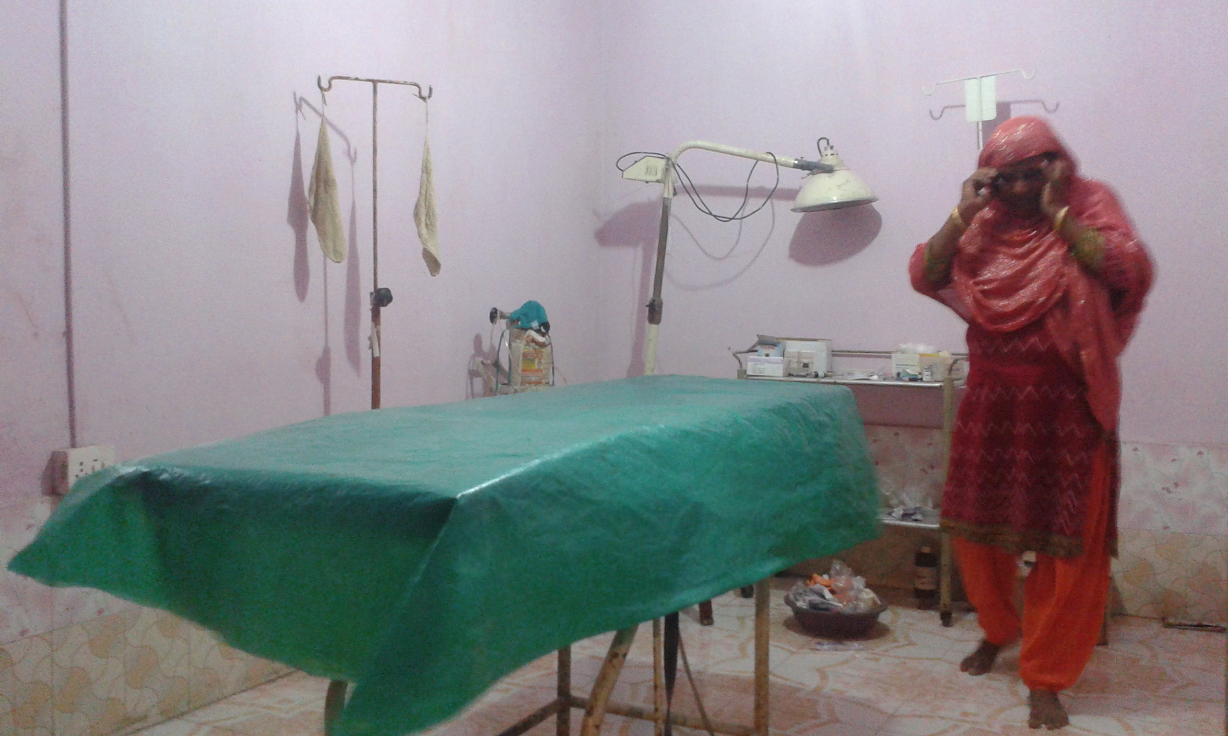
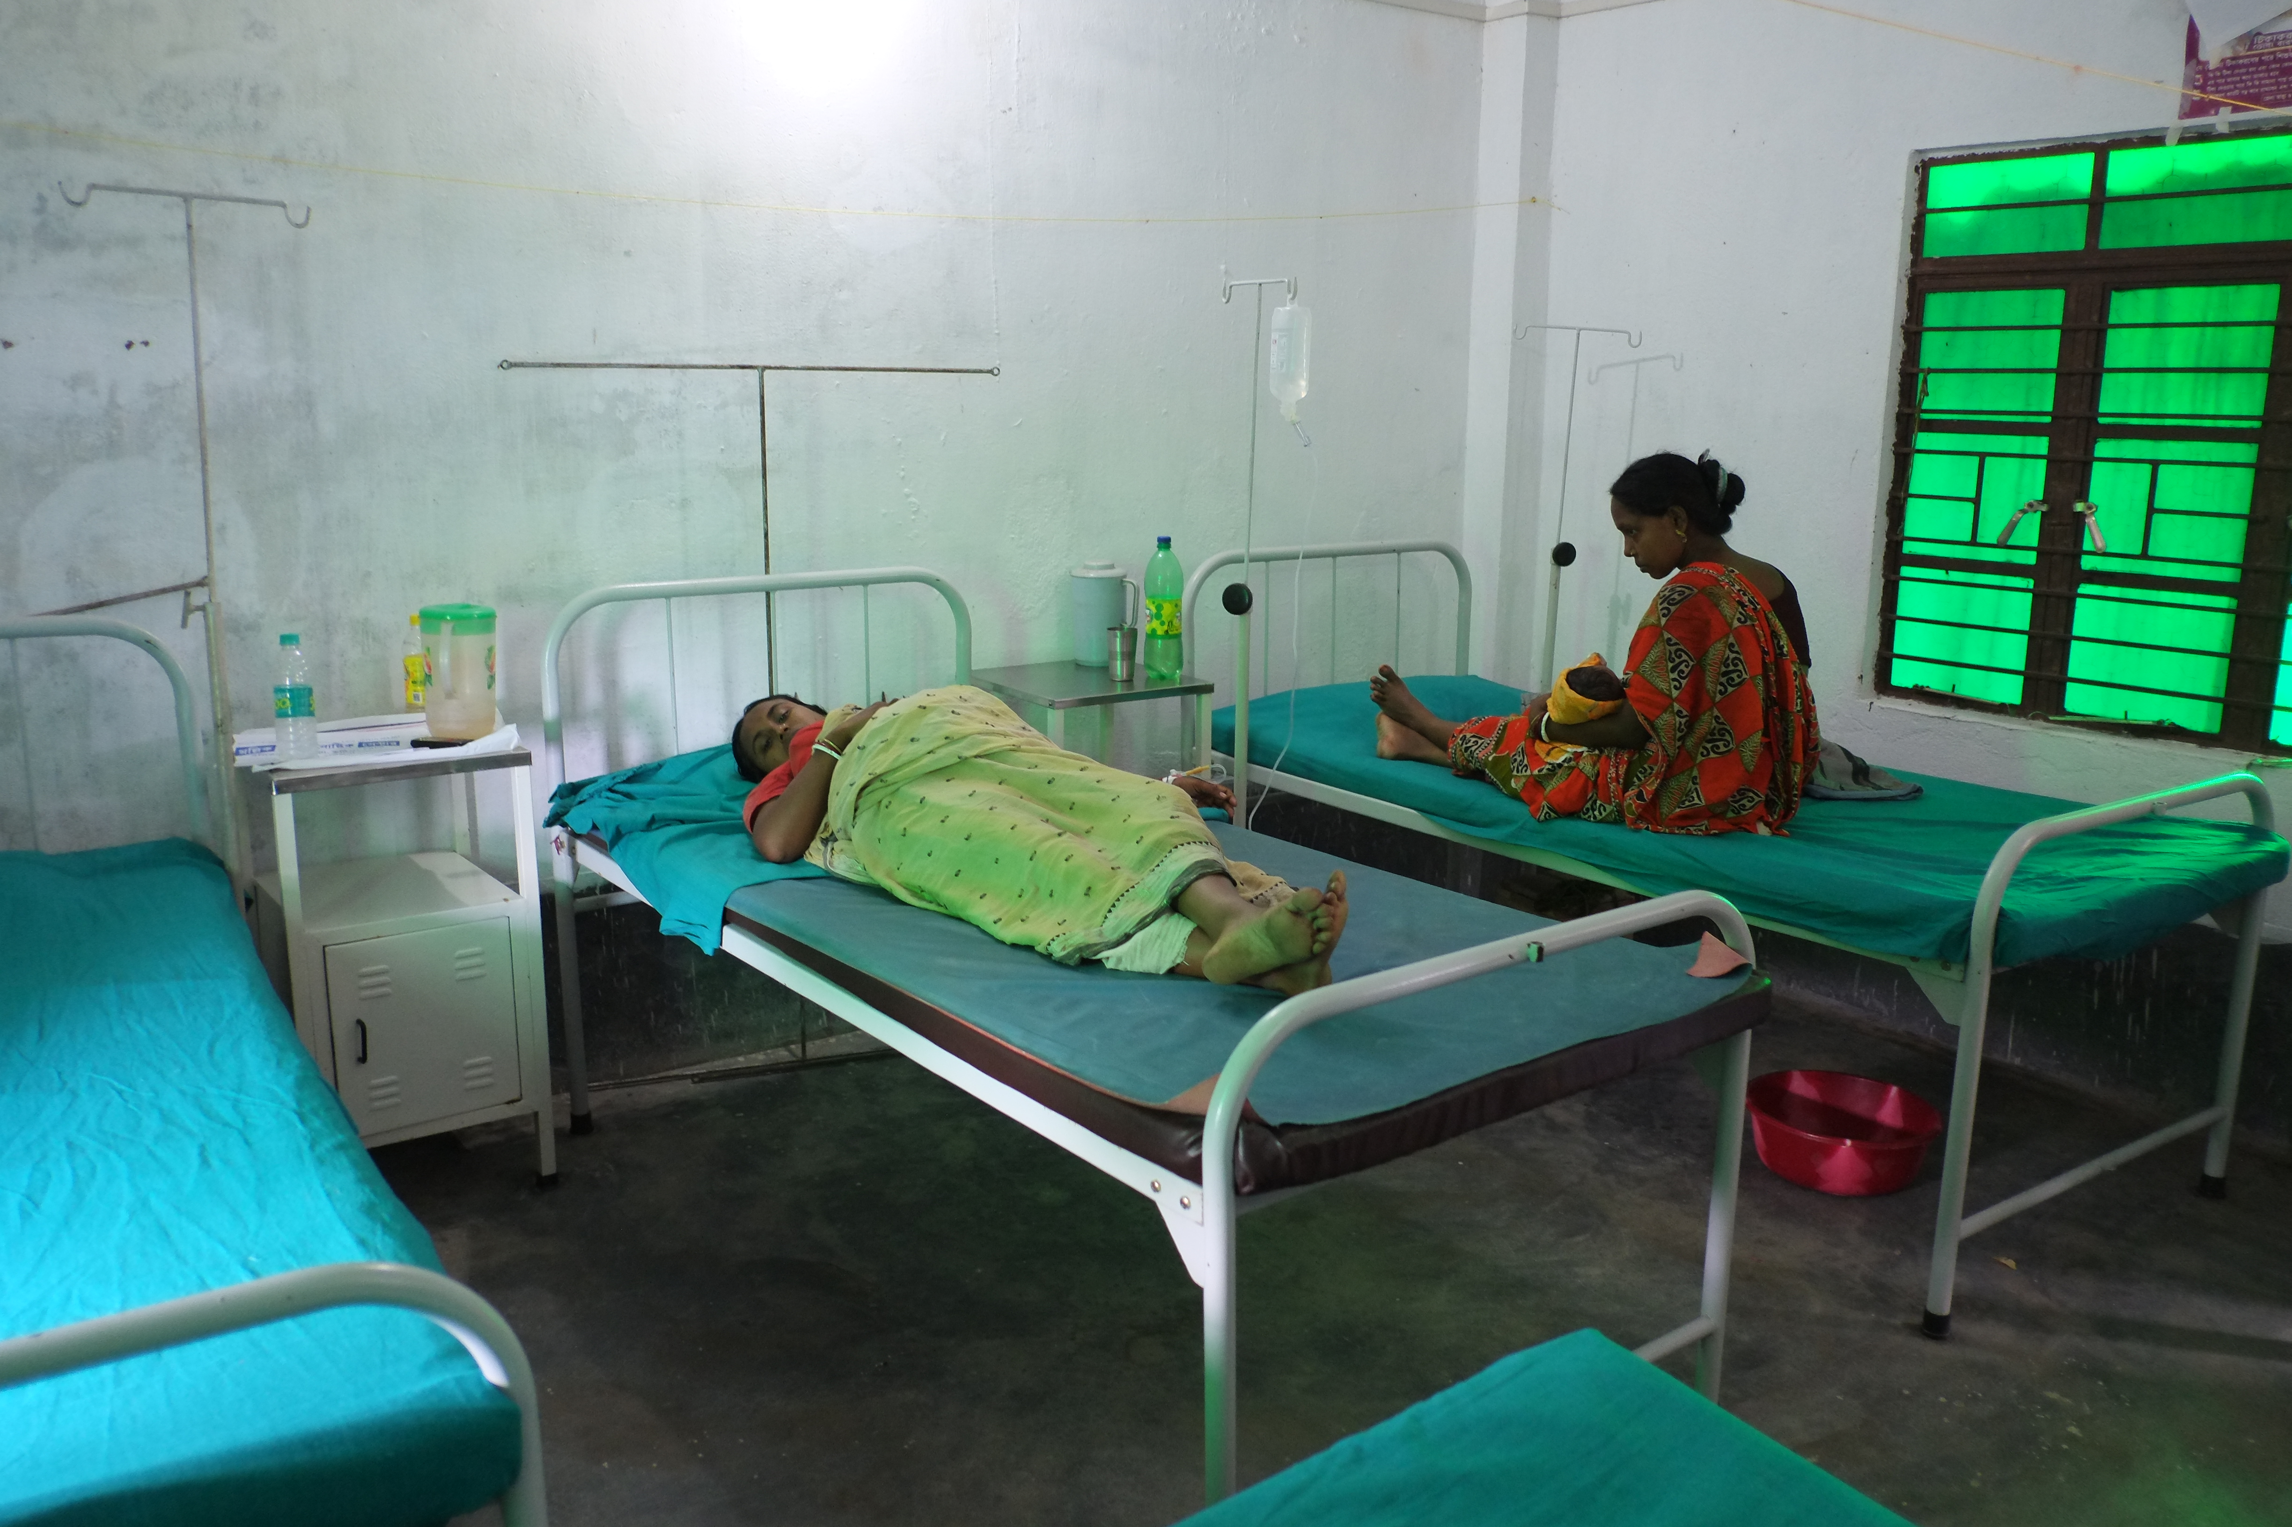
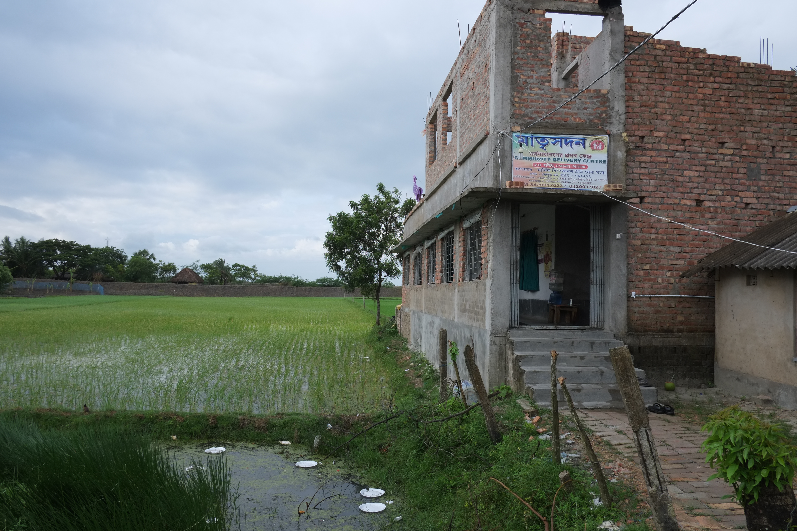
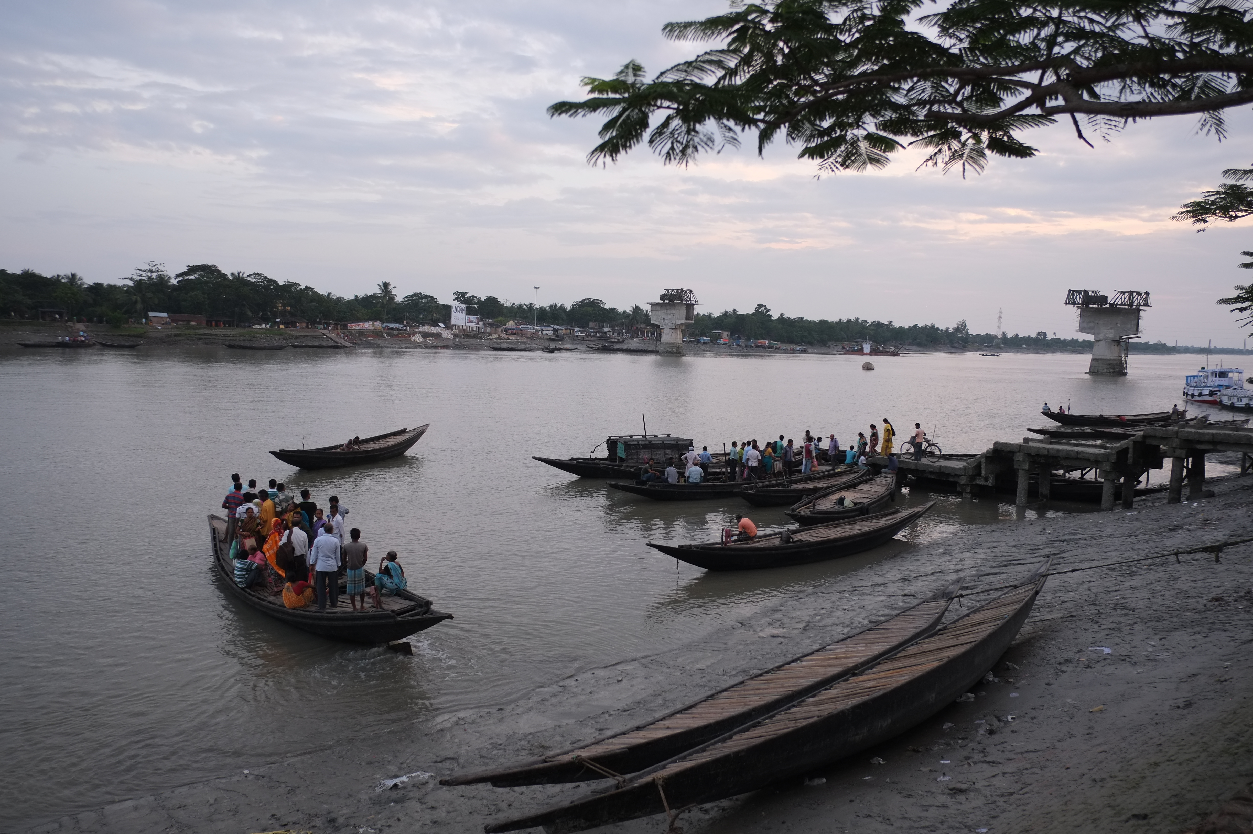
Private facilities: features
Outnumber public facilities 2:1
Licensed and unlicensed
Bed strength : 5 to 500
Public private partnerships
72
Notes:
These pictures are from West Bengal but a lot of the content applies to UP also. Private facilities that can provide inpatient care and are equipped to do deliveries are double the number of public facilities in both districts. Size varies from small 3-5 bedded to 500 bedded corporate hospitals. The majority have less than 20 beds, and the focus is on C-secs and other small surgeries. There are also unlicensed facilities that do C-secs. We found these in the more remote areas and these also do C-secs. Providers are not medically qualified but learn through apprenticeships. Charges about 2500 for a C-sec whereas in the city it will cost almost 15000. Then there are PPPs in West Bengal – CDCs for increasing access to institutional deliveries in very remote areas. Have to reach here by boat. Govt pays them 5000/delivery and 1000 to the woman. Also ayushmati centres at accredited for profit facilities to increase access to C-secs. But pref here for normal deleiveris as the amount reimbursed is very small – 3,200 only. Also talk a bit about unregistered facilities – how many estimated ones? What people told us in both districts.
Canning block – 2 PHCs, 200,000 pop and 15 unlicensed.

Slide 73
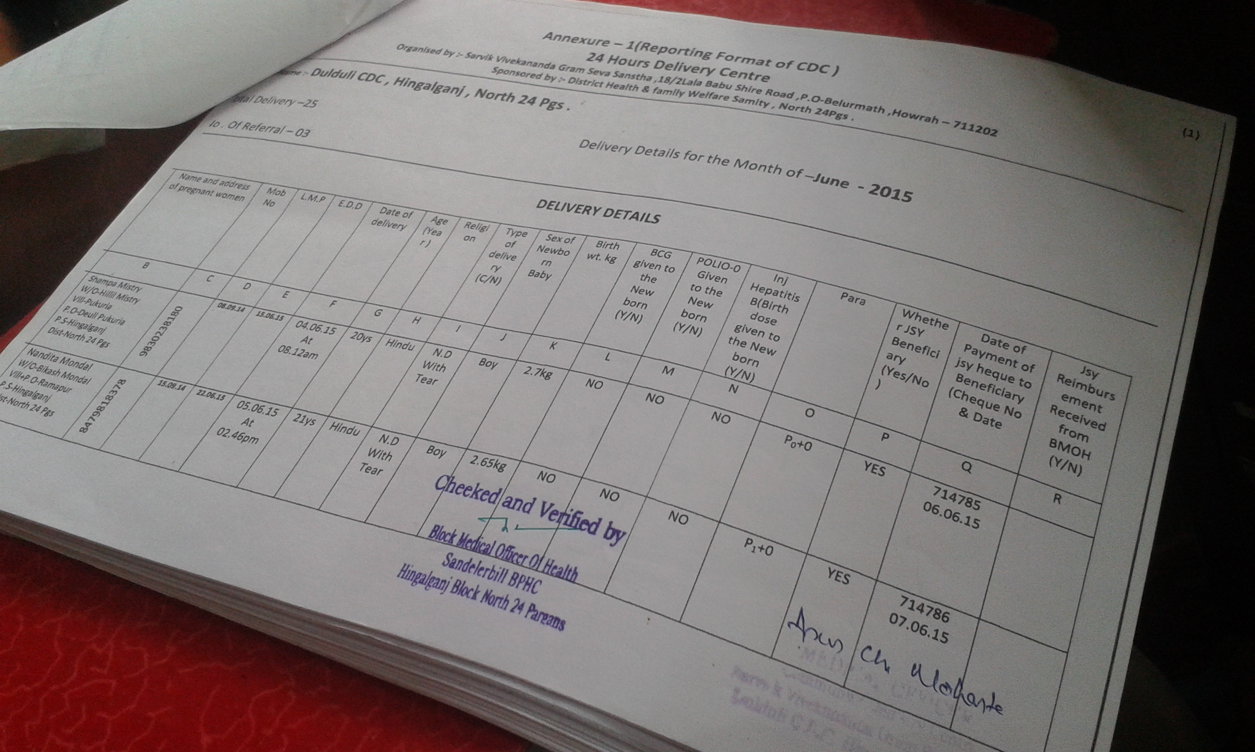
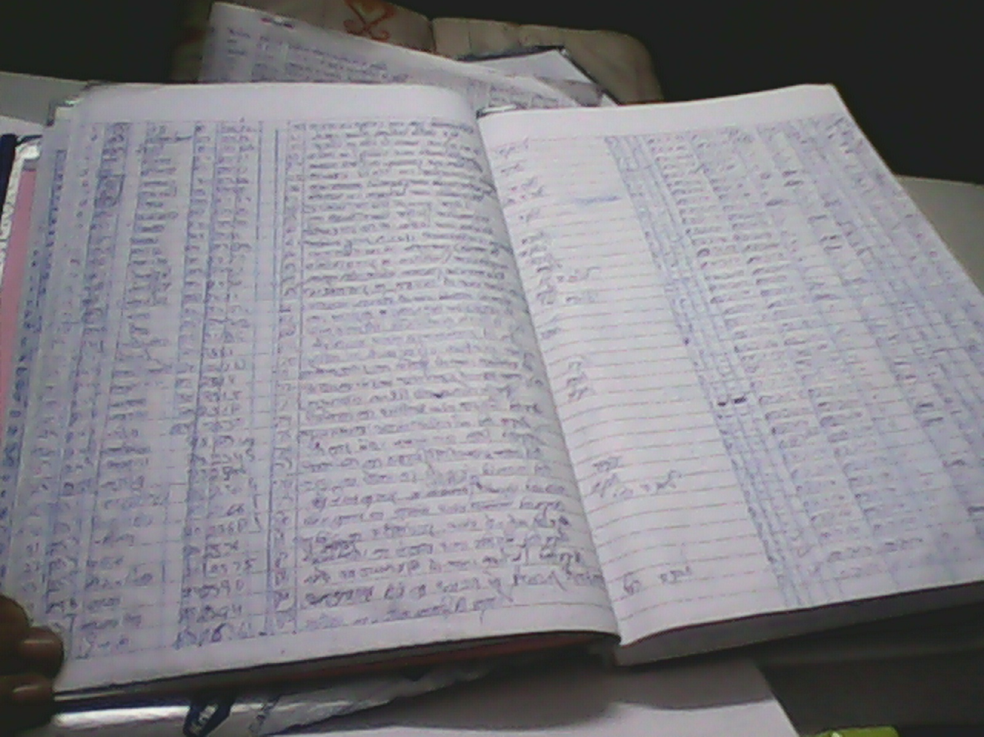
Good data sharing for legislated services and PPPs, but not other services
Standardised and regular data sharing:
Ultrasound services
Medical termination of pregnancy
Institutional deliveries by Community delivery centres
Caesarean and normal deliveries by Ayushmati centres
Online registration by private facilities in West Bengal
Varying and irregular data sharing:
By all other private for profit facilities, although most maintain basic data
No data sharing:
By private unlicensed facilities
73
Notes:
Important point – contrary to our assumption that the private sector does not share any information or reports we found that all those facilities registered for ultrasounds and MTPs were reporting detailed timely reports on these. The district health departments also monitor these facilities regularly. The PPPs in West Bengal also share meticulous records with the health department. – both CDCs and the Ayushmati centres. Data is also checked and verified by the block medical officers.
However, data sharing by other private facilities for deliveries and newborn care varies from district to district and facility to facility. In South 24 parganas its quite high – 174/230 while in North 24 parganas hardly 10-15 share. Some do it on manual hand written forms while others do it on computerised formats. The unlicensed do not share any data at all.

Slide 74
Factors affecting routine MNCH data sharing
Lack of a legal framework
Health department’s limited perceived utility for the data
Health department’s limited capacity to handle and utilise the data
Lack of communication/
follow up by district/state
Inadequate, non-standardised data systems
PRIVATE FACILITIES:
-Fear of information disclosure
-Fear of effort required
-Lack of incentives
-But general willingness
74
Notes:
This is an over view of factors affecting data sharing. I am highlighting the barriers here. Legal frameworks are important. Public sector officials said that we cannot force them to give any data as there is no legal mandate for that. But private facilities may interpret that differently. Many said that if there is an official notification from the state, they will have to share data. But it is also to do with the health department’s limited perceived need which leads to inadequate capacity for handling the data as embodied by inadequate data capturing and management for private sector data and also a limited push on the private sector to share data – no communication or follow up. For the legislated services these systems are very well worked out. On the private sector side they do have some apprehensions about information disclosure to the tax department and the level of effort required, but there was a general willingness to share data, esp public health data, if asked to do so.

Slide 75
Conclusions
Private sector data is necessary for monitoring health services and outcomes
Legislation is important but not the only prerequisite for public private data sharing
Public health departments need to perceive value for data and develop data systems and utilisation mechanisms
Private sector willingness to share public health data and also for other health engagements needs to be harnessed
75

Slide 76
Summary
The ‘Data-Informed Platform for Health’ introduces a data-based, structured decision-making process at district level
Literature review shows examples of good practice, but no guideline for decision-making at district level
Health ministry staff and other stakeholders are receptive
Private sector (India) shows willingness to participate
At district level, many health data are available but streamlining is needed
Feasibility in Nigeria, Ethiopia and India
  Challenging, need to adapt to context
  Pilot work ongoing in India
76

