Slide 1
Catalysing scale-up of maternal and newborn child health innovations: a qualitative study in Ethiopia, Uttar Pradesh, India and northeast Nigeria
Dr. Neil Spicer
London School of Hygiene & Tropical Medicine
neil.spicer@lshtm.ac.uk
Global Maternal Newborn Health Conference
18th – 21st October 2015
Improving health worldwide
ideas.lshtm.ac.uk

Slide 2
Overview
‘IDEAS’ - Informed Decisions for Actions in maternal & newborn health
Measurement, Learning and Evaluation grant by the Bill & Melinda Gates Foundation to the London School of Hygiene & Tropical Medicine since 2010
Aims to improve evidence for maternal and newborn health (MNH) policies and programmes
Working in three high maternal and newborn mortality areas –
Northeast Nigeria
Uttar Pradesh in India
Ethiopia

Slide 3
Our objectives
To build capacity for measurement, learning and evaluation
To characterise innovations
To measure efforts to enhance interactions between families and frontline workers and increase the coverage of critical interventions
To explore scale-up of maternal and newborn health innovations
To investigate the impact on coverage and survival of maternal and newborn health innovations implemented at scale
To promote best practice for policy

Slide 4
Our objectives
To build capacity for measurement, learning and evaluation
To characterise innovations
To measure efforts to enhance interactions between families and frontline workers and increase the coverage of critical interventions
To explore scale-up of maternal and newborn health innovations
To investigate the impact on coverage and survival of maternal and newborn health innovations implemented at scale
To promote best practice for policy

Slide 5
Qualitative study of scale-up
Aims
To identify key actions to catalyse scale-up of externally funded MNH innovations – Gates Foundation/other MNH donors
To identify contextual factors enabling or inhibiting their scale-up
Definitions
‘Scale-up’: increasing the geographical reach of externally funded MNH innovations to benefit a greater number of people beyond grantee programme districts
‘Innovations’: new interventions within a context to enhance interactions between frontline workers and households - examples -
Mobile phone app with health communication messages
Community health workers trained to administer antibiotics to newborns
Emergency transport scheme to promote facility births

Slide 6
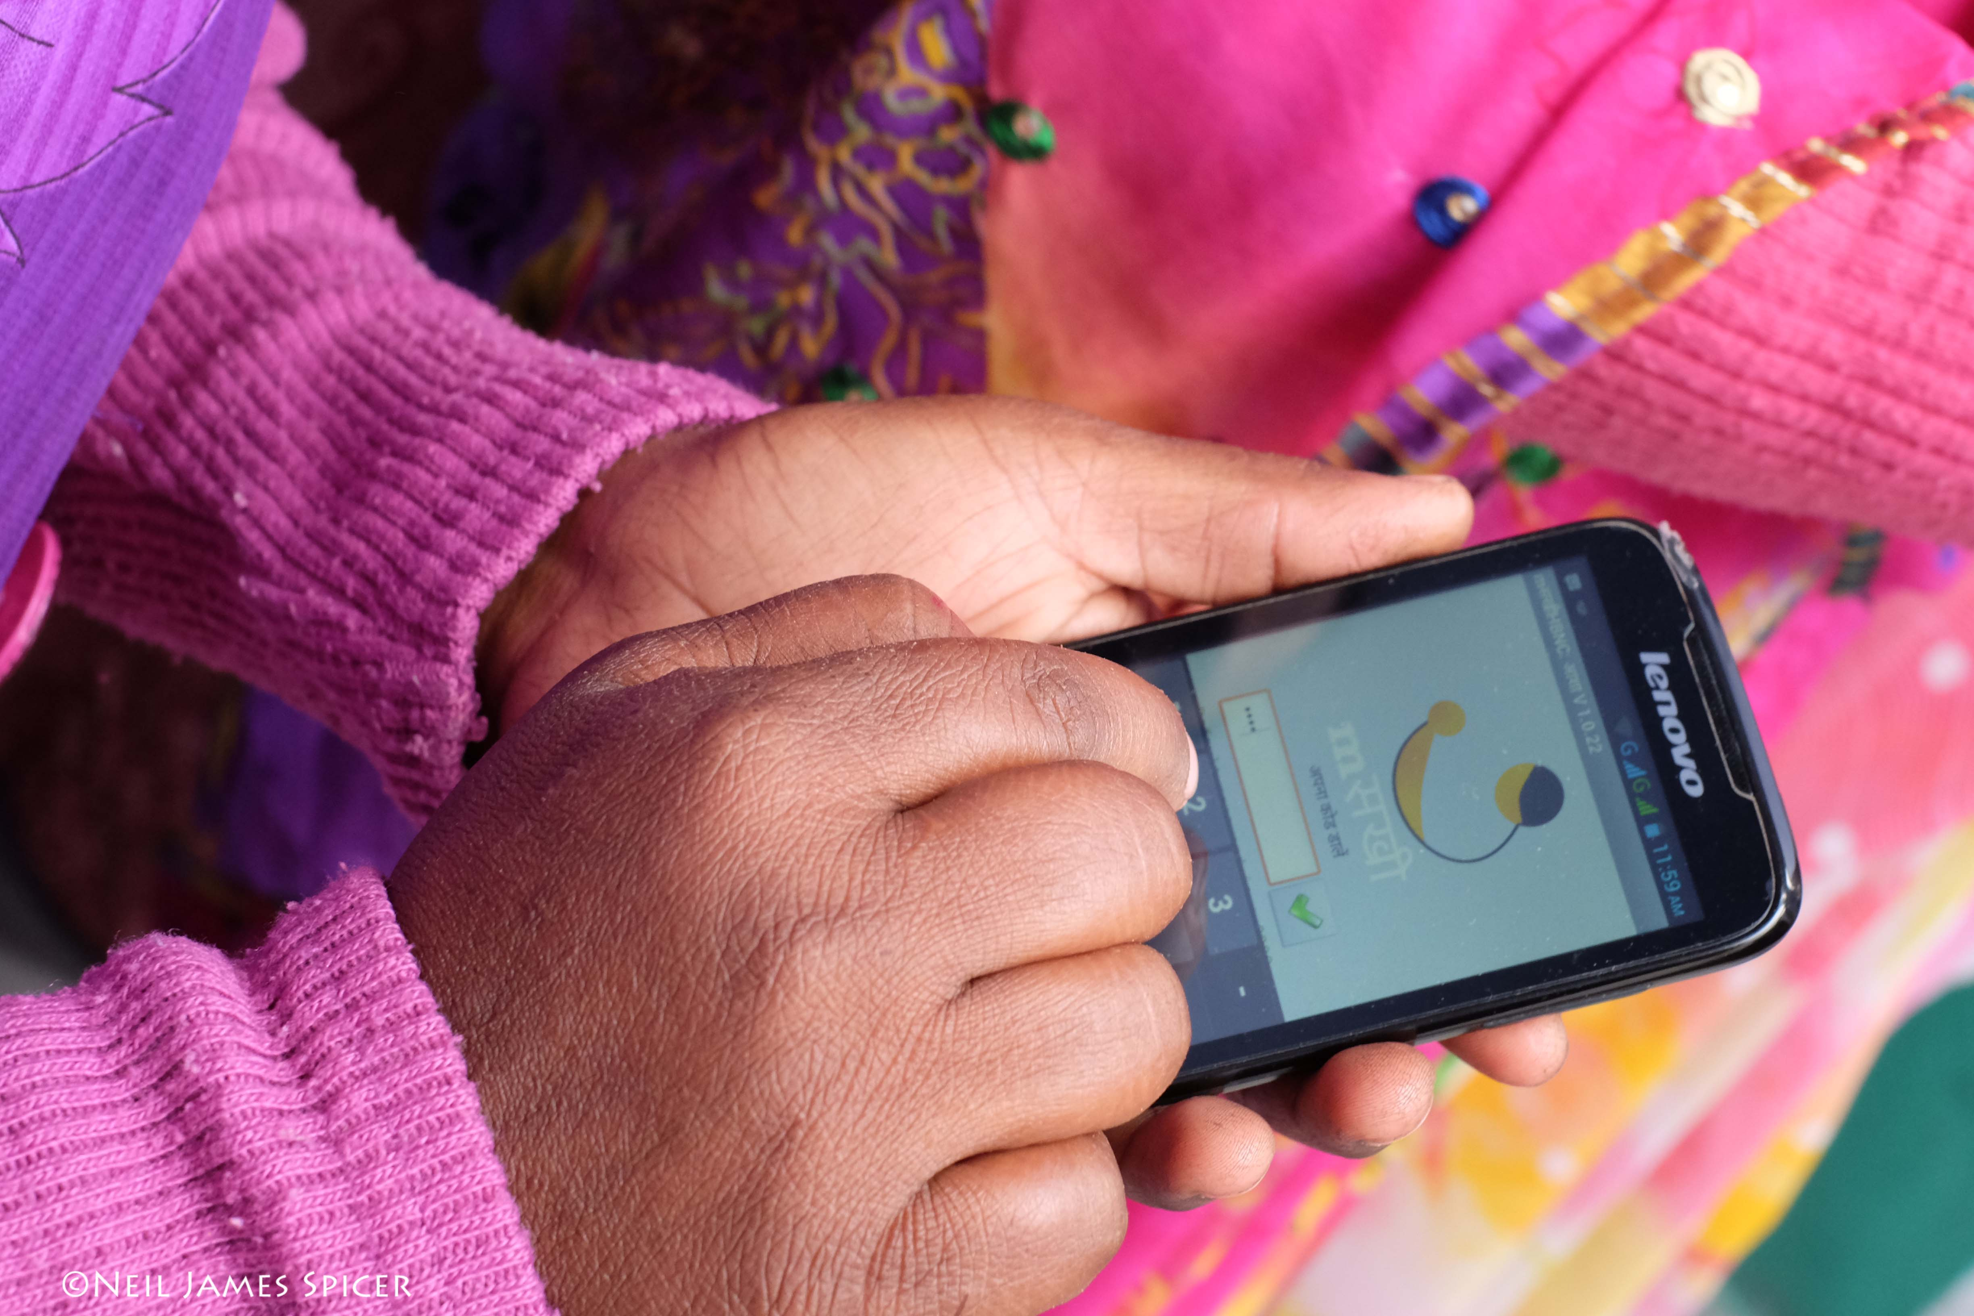
Methods
In-depth qualitative interviews: 150 (2012/13) and 60 (2014/15)
Stakeholders in MNH: government; development agencies; implementers; professional associations; academics/experts; frontline workers
Analysis: comparative thematic analysis using a common analytic framework
Validity: data triangulation; investigator triangulation; member checks

Slide 7
Evidence informed framework of scale-up
STAGE
ACTIONS
CONTEXT
Designing for
scale-up
Planning, assessment & sensitisation
Designing scalable innovations
Health governance
Prioritisation of health issues
Development partner coordination
Decision making
Presenting strong evidence
Harmonisation , alignment & country ownership
Invoking powerful individuals
Responsiveness and flexibility
Delivery at scale
Supporting ‘transition’ to scale
Review & modification
Strengthening health systems capacity
Health systems capacity
Security
Demand & uptake
Engaging community ‘opinion leaders’
Engaging media
Socioeconomic and cultural contexts
Geographical contexts

Slide 8
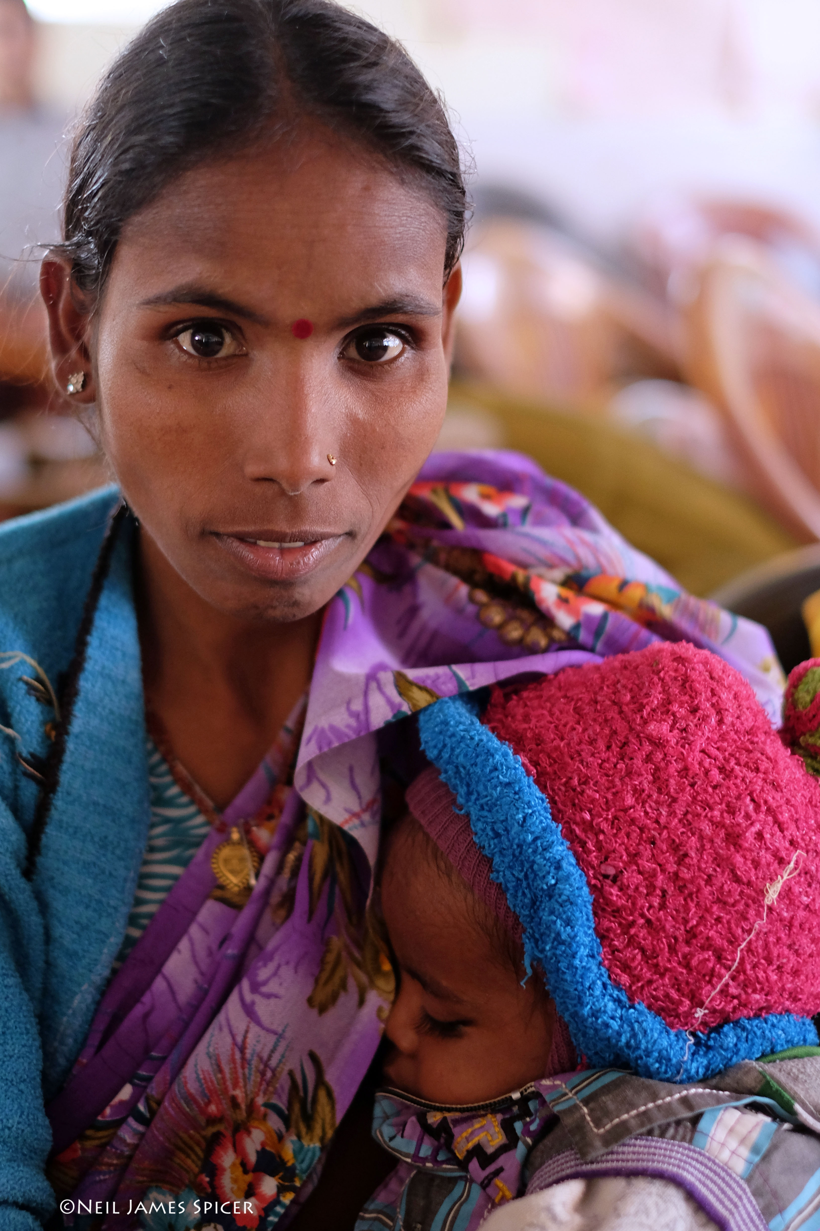
STAGE ONE: DESIGNING FOR SCALE-UP
Making scale-up an integral part of the project

Slide 9
Designing innovations to be scalable
Effective
Comparative advantage over alternatives
Observable effects/impacts
Simple
Easy to use by health workers and communities: ‘...it’s feasible to train them and it doesn’t take an entire lifetime to learn...’
Low financial and human resource inputs
Appropriate
Needs and priorities of health workers and communities met: ‘The innovation makes health workers enthusiastic...it decreases their workload by some amount...’
Culturally acceptable
Adaptable to different geographic settings
Aligned
Builds on existing policies and programmes

Slide 10
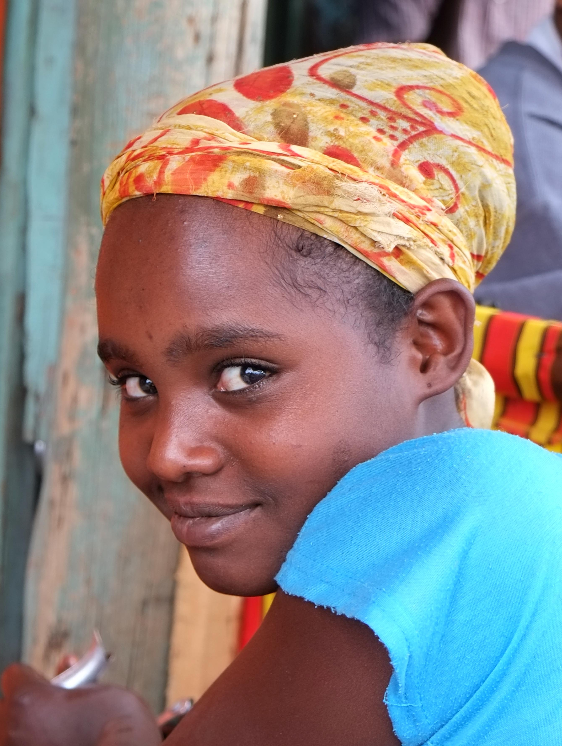
Tension between effective ‘boutique projects’ and simple, low cost, scalable innovations:
‘Most innovations succeed in their pilot phase because of intensive resources and a determined view of recording a success story...’

Slide 11
Planning, assessment and sensitisation
Planning for and resourcing scale-up
Developing a scale-up plan that is integral to a project: ‘…if you plan scale-up when your pilot is over then there are many things you can’t go back and correct...’
Dedicating staff and resources for scale-up activities e.g. advocacy and evaluation officers
Assessing the context
Policies, systems, community and health worker needs/norms - to inform innovation design and scale-up plan
Stakeholder analysis to identify potential supporters, partners and rivals
Sensitisation
Early (and ongoing) stakeholder involvement to engender ownership and trust: ‘It requires spending a lot of time with relevant people, sitting down, exposure and discussion...’

Slide 12
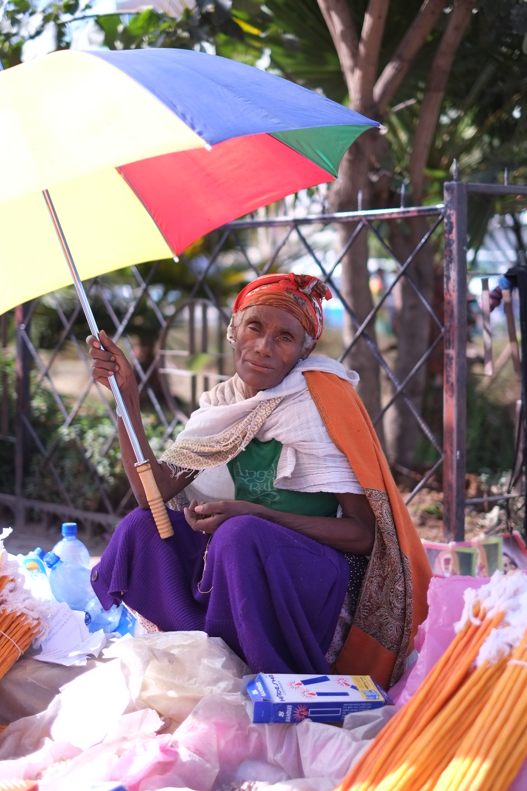
STAGE TWO: DECISION MAKING
Influencing decision makers to adopt and finance an innovation at scale

Slide 13
Strong base of evidence
Quantitative evidence: demonstrating innovation effectiveness
Decisions not always based on effectiveness data
‘Experiential’ evidence: project visits, meeting beneficiaries: ‘...take decision makers to the field...this way we get emotional buy-in’
Cost data: cost effectiveness/cost estimates of scaling innovation: ‘When it’s required to take it to scale government first asks - “what’s the cost?”...’
Qualitative data: implementation lessons showing how to scale an innovation
Secondary data and needs assessments: demonstrating innovation addresses important health needs

Slide 14
Alignment and country ownership
Alignment
Aligning innovation with government programmes and priorities is critical to government uptake
Ensuring evidence aligns with government targets/indicators: ‘...the ministry wants to see how the innovation contributes to the ministry and to health...’
Synchronising advocacy and communication with decision making cycles
Country ownership
Ongoing government engagement in design, planning, evaluation strengthens country ownership: ‘...involving decision makers in every step, creating ownership, creating trust by filling gaps and supporting their initiatives...’

Slide 15
Harmonisation
Embracing country coordination bodies
Implementer and development partner voices more unified when presenting evidence – if not: ‘Government is bombarded with information; it’s difficult to synthesise and make meaningful decisions [about scale-up]’
Platform for exchanging learning to strengthen innovations: ‘Instead of wasting time reinventing the wheel we really need to come together...’
Working in partnership
Building broad support across government ministries, development partners, professional associations, communities

Slide 16
Power of individuals to catalyse scale-up
Support of influential individuals more critical than formal government engagement:
Key government personalities
Well-connected and respected ‘champions’: ‘If you ask me any single thing I think it’s [this person’s] vision, passion and belief - one [person] can make a difference!’
Charismatic project leaders: ‘...it’s less to do with a clearly articulated scale-up strategy...it´s the personalities and leadership of that project’
Influential traditional and religious leaders e.g. Emirs of Nigeria

Slide 17
Responsiveness and flexibility
Designing project and preparing for scale-up important but...
Responding to changes in country policies, programmes, priorities, reshuffling and attrition of government staff
Waiting until time is right - responding to policy windows: ‘[events came together] in a certain pivotal moment where the Ministry decided there’s going to be a policy shift...[the implementer was] flexible and nimble...recognising there’s an opportunity...’

Slide 18
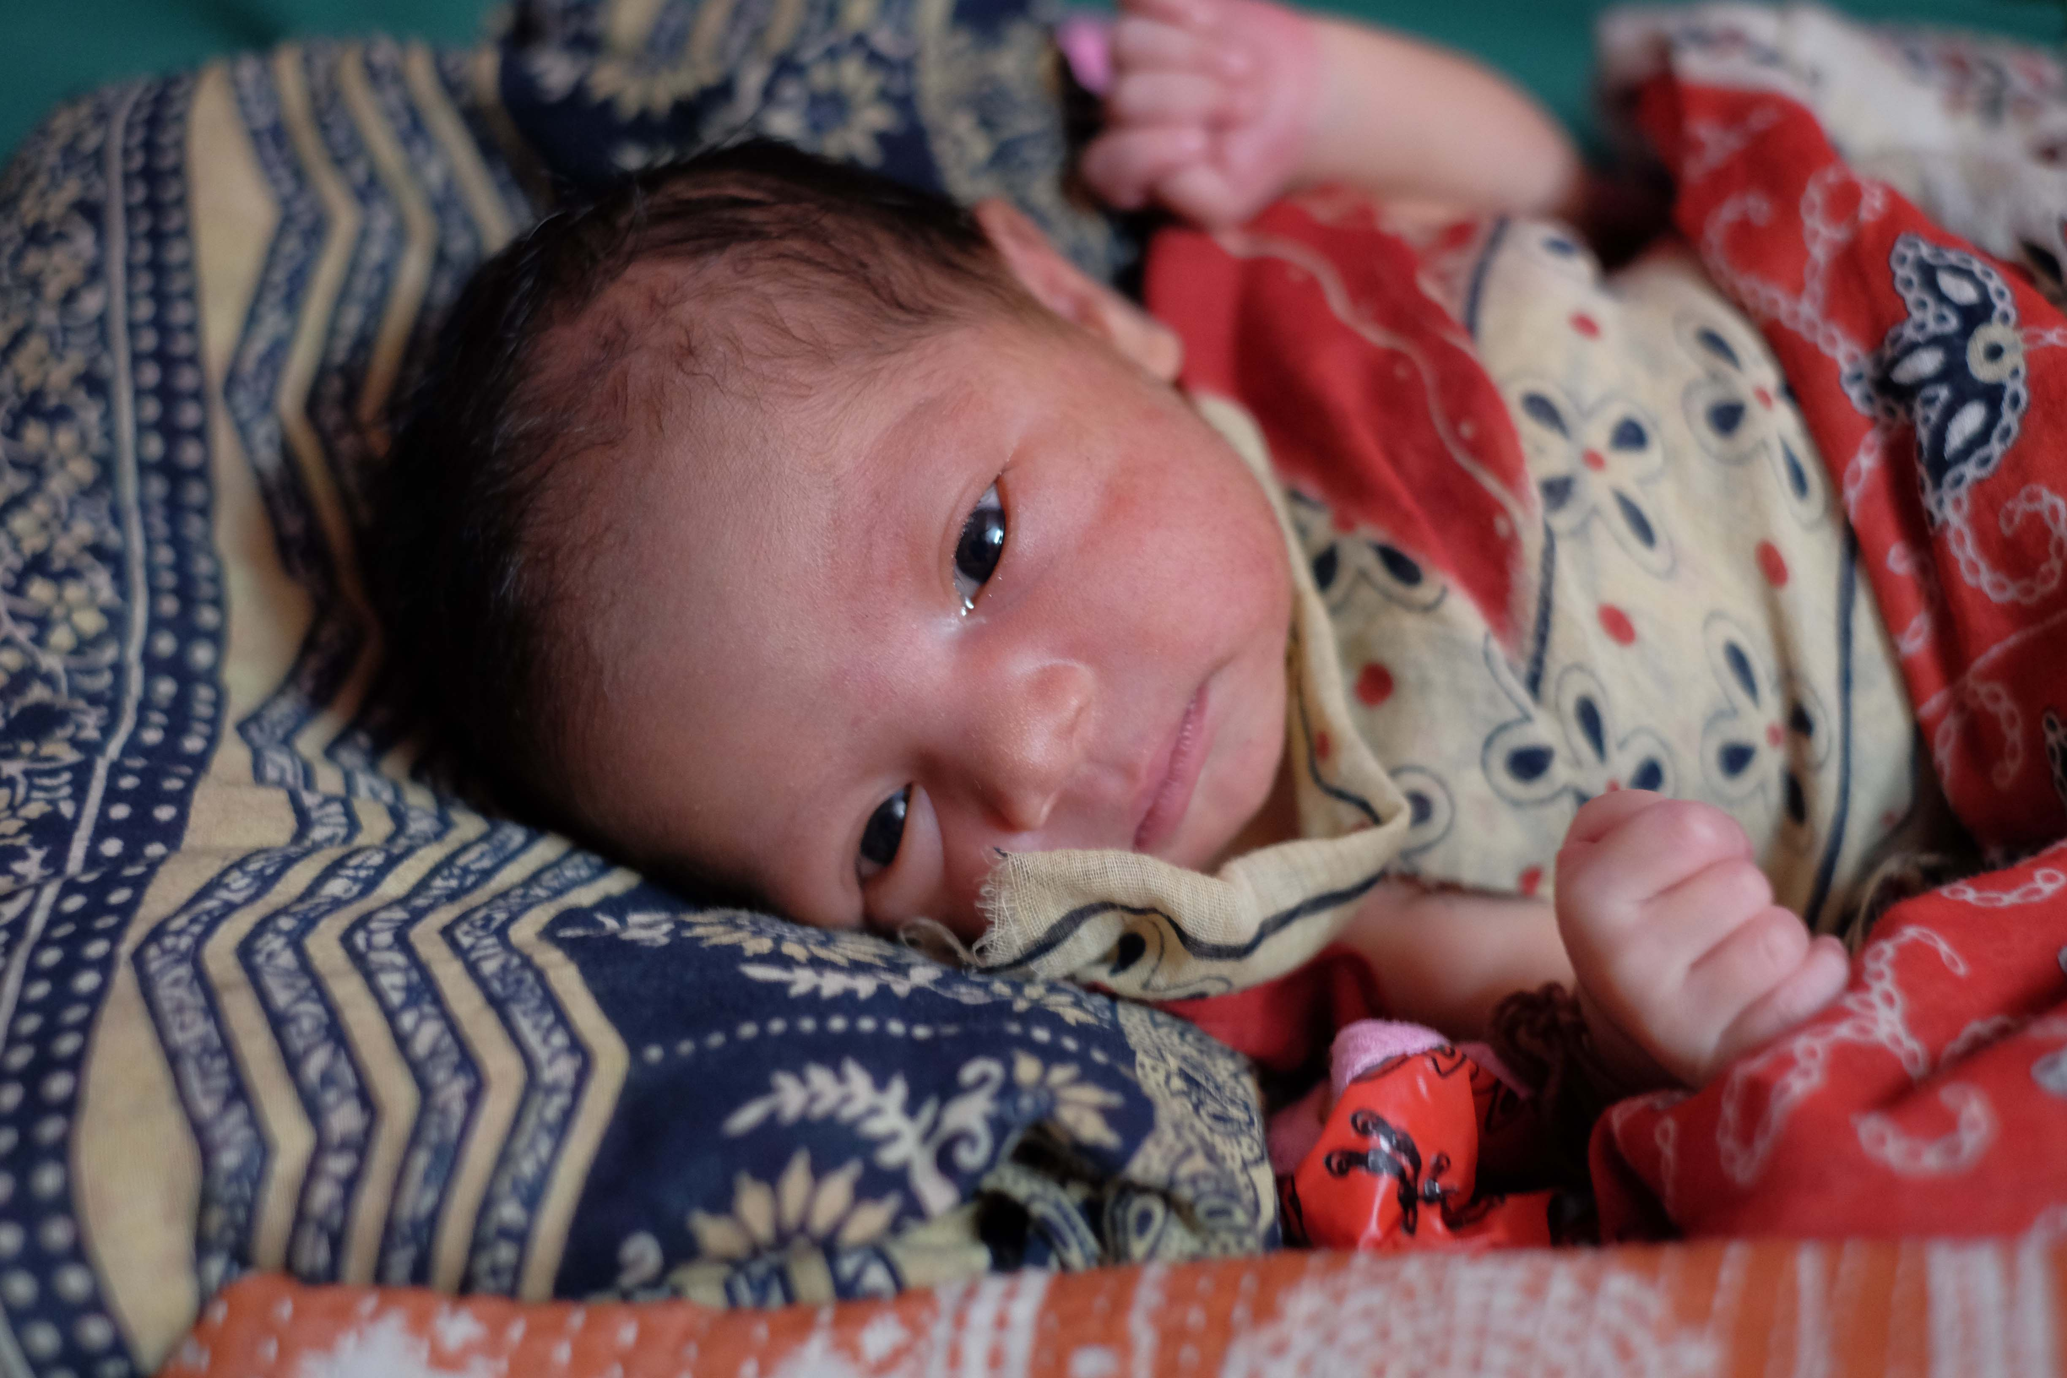
STAGE THREE: DELIVERY AT SCALE
Supporting the implementation of an innovation at scale

Slide 19
Working with government in ‘transition’ to scale
Providing technical assistance
Participating in developing programme at scale
Feeding in operational lessons, evidence and project resources
Harnessing experience of project staff: ‘[government] are doing it for the first time...if we were there, then their absorption power would be far greater...’
Review and modification
Reviewing and modifying innovation for scale e.g. selecting effective and cost effective elements
Strengthening government capacity
Staff, organisational and systems capacity to scale innovations: ‘You have to do some capacity building with those you want to work with – that’s the reality...’

Slide 20
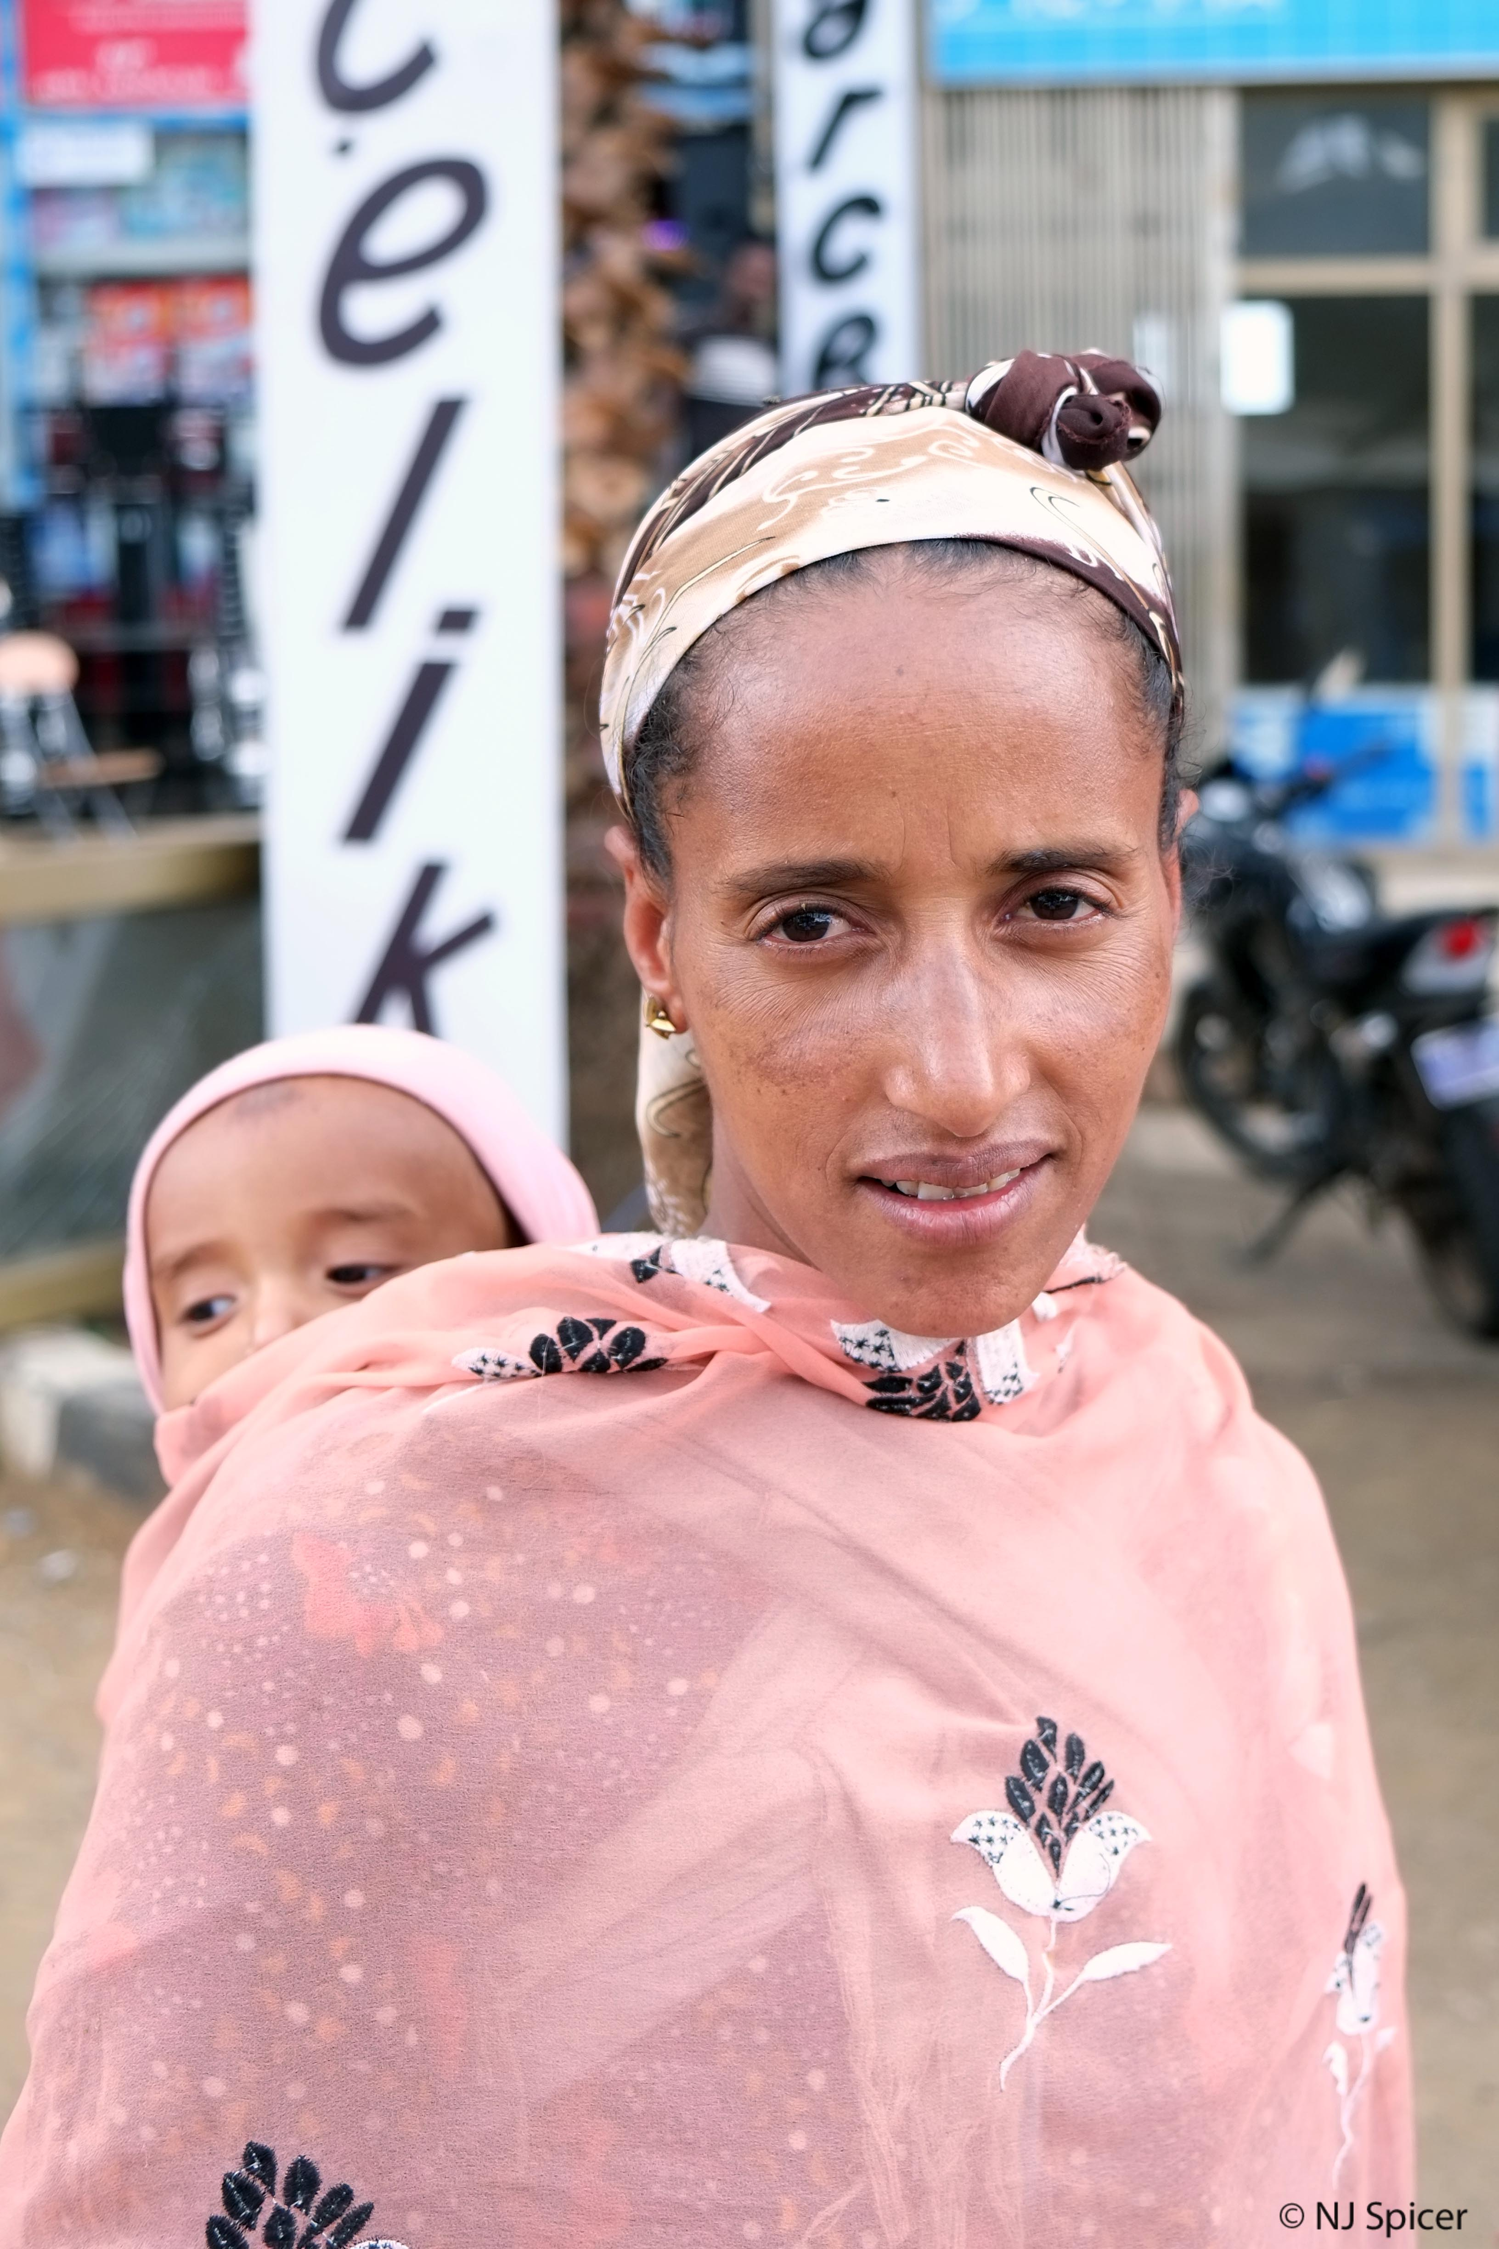
STAGE FOUR: DEMAND AND UPTAKE
Fostering community demand and uptake of an innovation at scale

Slide 21
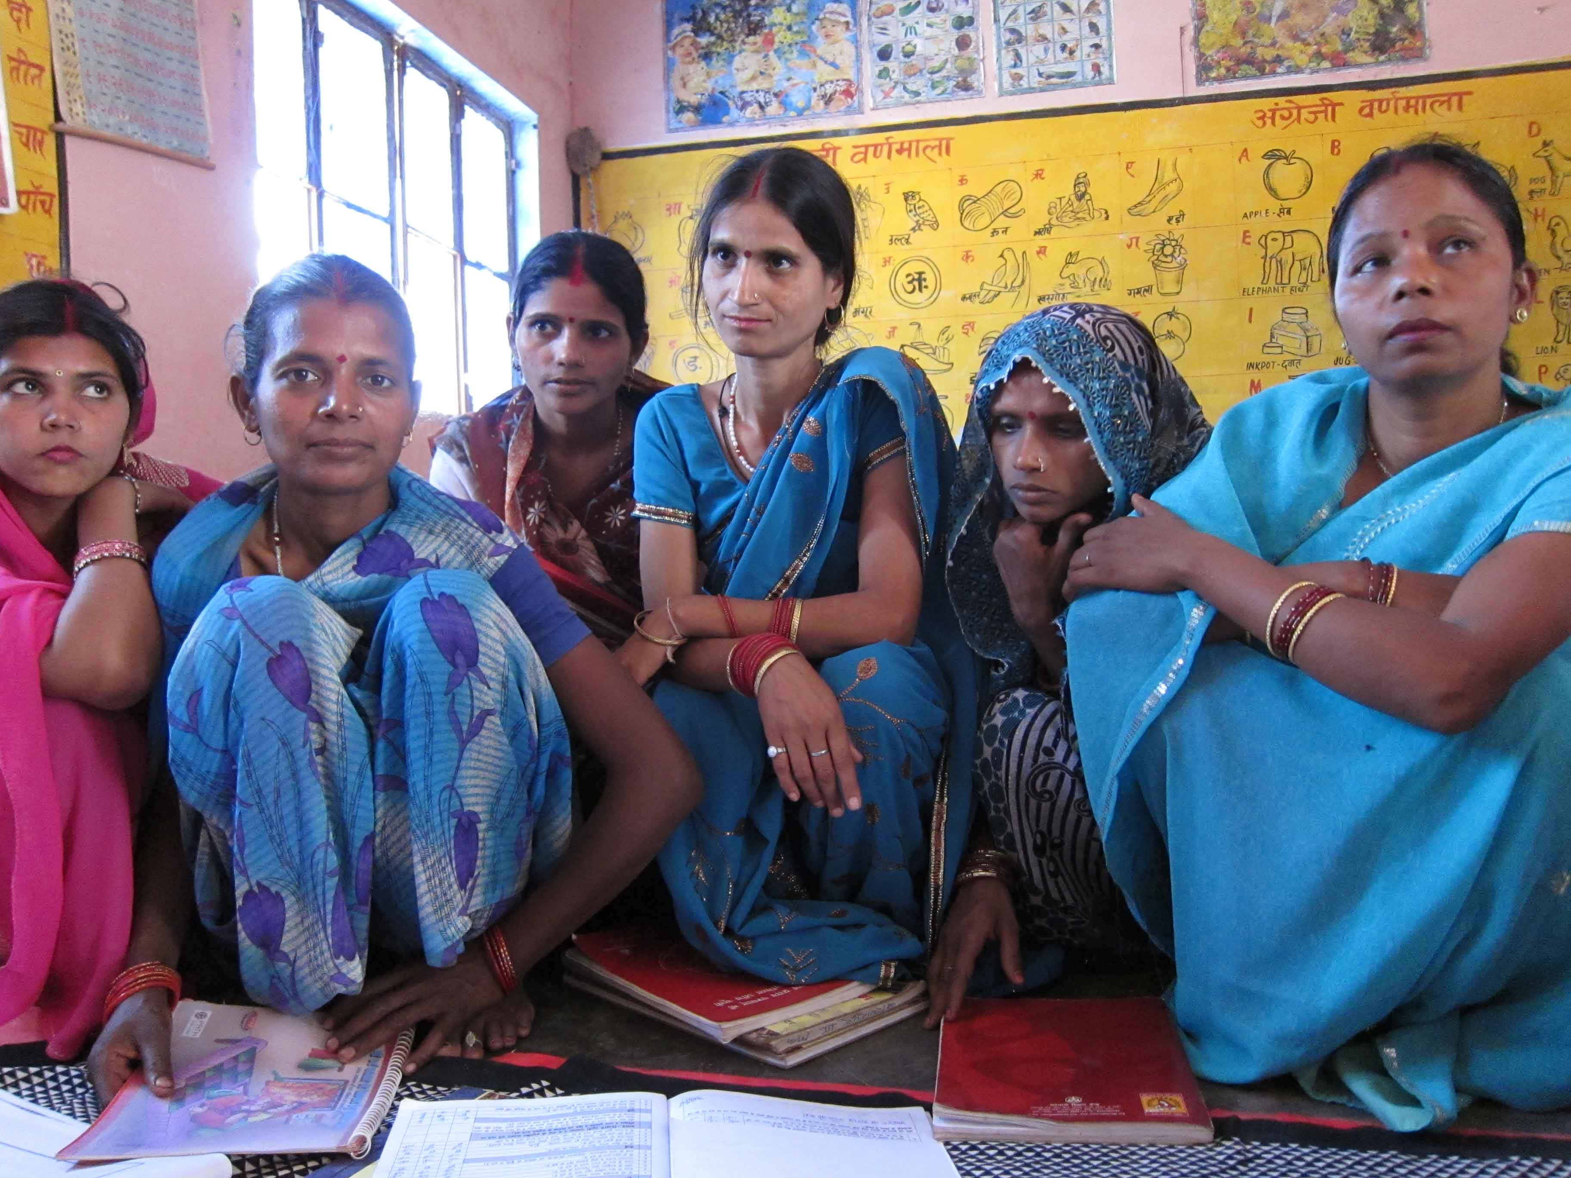
Stimulating community demand and uptake
Invoking community leaders
Working with traditional and religious leaders, churches and mosques, community groups to propagate acceptance
Media champions, celebrity endorsement
Media training and sensitisation and celebrity endorsement to foster acceptance of innovations among communities

Slide 22
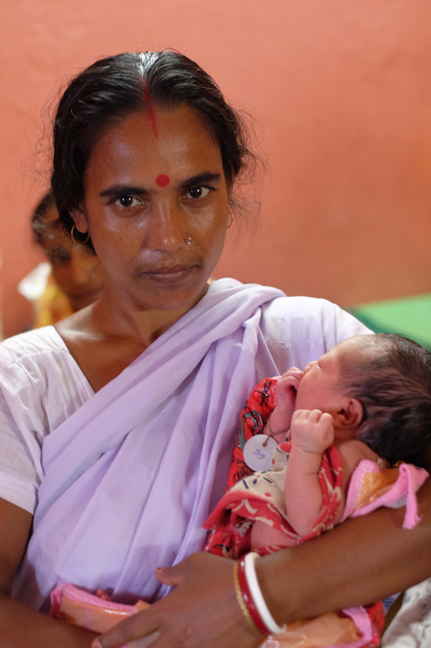
DONOR AND GOVERNMENT ACTIONS TO CATALYSE SCALE-UP

Slide 23
Donor actions
Incentivising implementers to integrate scale-up within project plans
Allowing flexibility in project plans to respond to change
Programme officers involved in catalysing scale-up: ‘Usually donors give money and you deliver the deliverables. But this was different – [the Program Officer] engaged in the MOH and in bringing grantees together...’
Supporting implementers during transition to scale
Embracing aid effectiveness principles – harmonisation, alignment and country ownership
Government actions
Working closely with implementers to maximise relevance and value of innovations
Strengthening donor coordination to foster exchange and capture of evidence

Slide 24
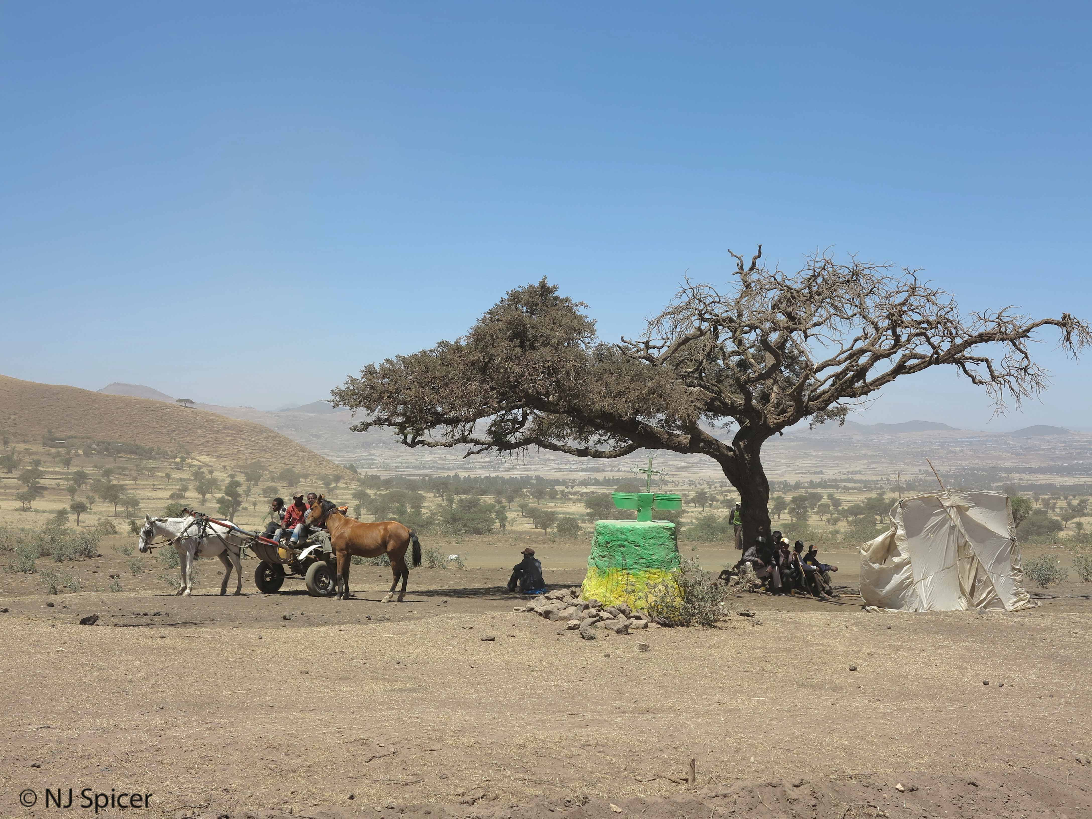
CONTEXT: BARRIERS AND ENABLERS TO SCALE-UP

Slide 25
Decision making
Prioritisation of health issues
MDGs made MNH a high policy priority in LMICs (+)
Supportive policy frameworks – National Health Mission in India and Health Extension Program in Ethiopia (+)
Limited public resources for rural health services in Nigeria: ‘...a lot of politicking and jostling for a piece of the cake...you struggle for monies for MNH...’ (-)
Harmonisation
Limited data sharing among development partners and implementers (-)
Governments starting to strengthen development partner coordination - especially Ethiopia (+)

Slide 26
Delivery at scale
Scaling innovations through ‘weak’ health systems challenging (-)
Human resources – shortages, high turnover, workloads: ‘Every new programme you have a new set of forms...that kinda adds a lot of workload...’ (-)
Northeast Nigeria security situation: ‘I know of some organisations that just closed down their programmes in the north..., (-)
Demand and uptake
Sociocultural beliefs and norms difficult to shift – especially hegemonic gender relations: ‘...a labouring mother is left alone in a dark place...the culture doesn’t allow women to deliver on the delivery couch...’ (-)
Poverty, geographical distances, difficult terrain (-)

Slide 27
Acknowledgements
Research partners:
Sambodhi (Uttar Pradesh, India): Sonali Swain; Dipankar Bhattacharya, Kaveri Haldar, Varun Mohan
Health Hub (northeast Nigeria): Ritgak Dimka; Felix Obi; Alero Babalola-Jacobs; Chioma Nwafor-Ejeagba, Yashua Alkali Hamza
Jarco (Ethiopia): Addis Woldemariam; Zewdu Sisay, Feleke Fanta, Feker Belete
IDEAS team including:
Deepthi Wickremasinghe
Dr Meenakshi Gautham
Dr Nasir Umar
Dr Della Berhanu
Interview participants in India, Nigeria and Ethiopia

Slide 28
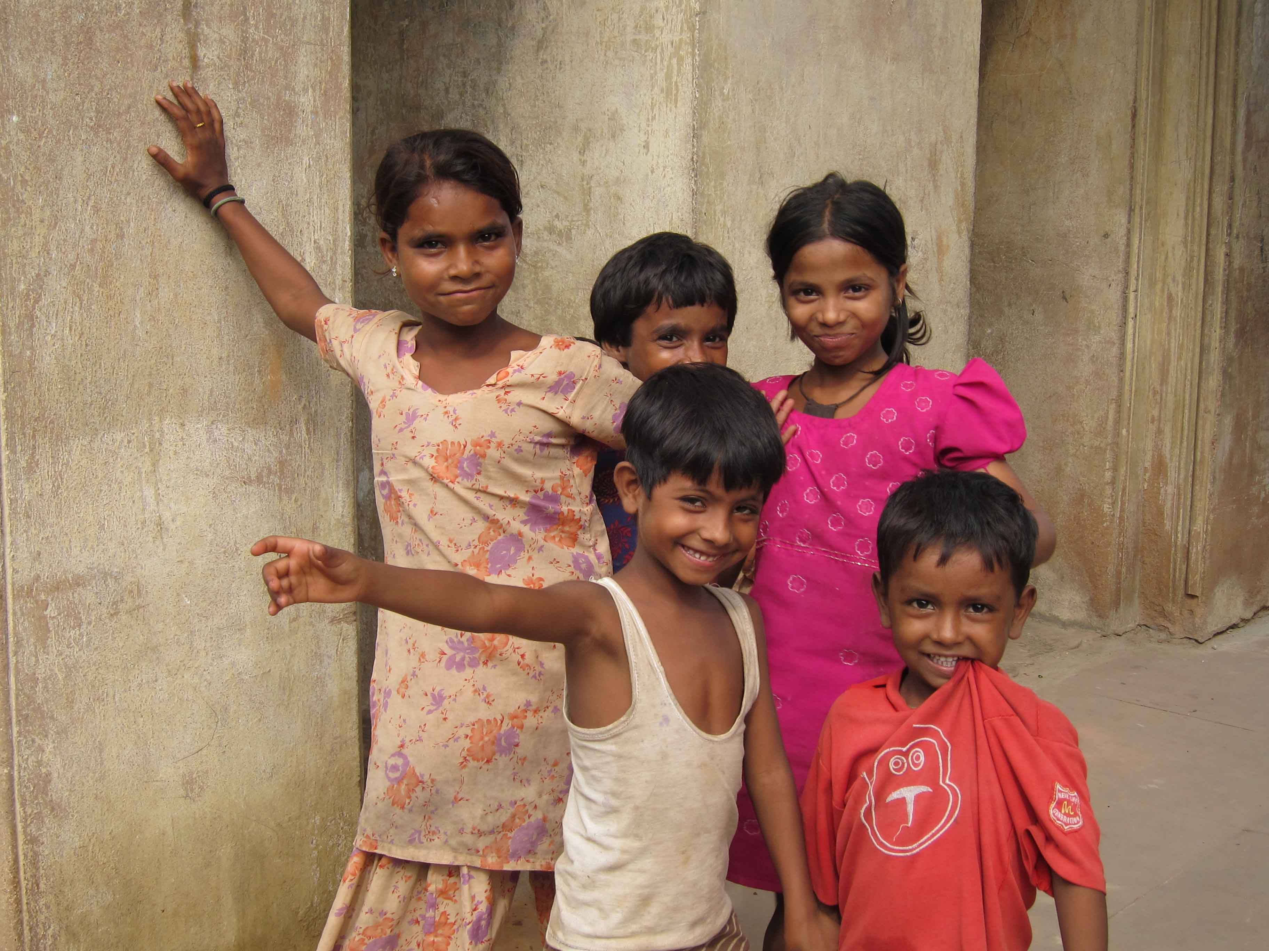
Contact us
Thank you!
IDEAS Project
Website: ideas.lshtm.ac.uk
Email: ideas@lshtm.ac.uk
Newsletter sign up: eepurl.com/j3iBz
Twitter: @LSHTM_IDEAS
neil.spicer@lshtm.ac.uk

