Slide 1
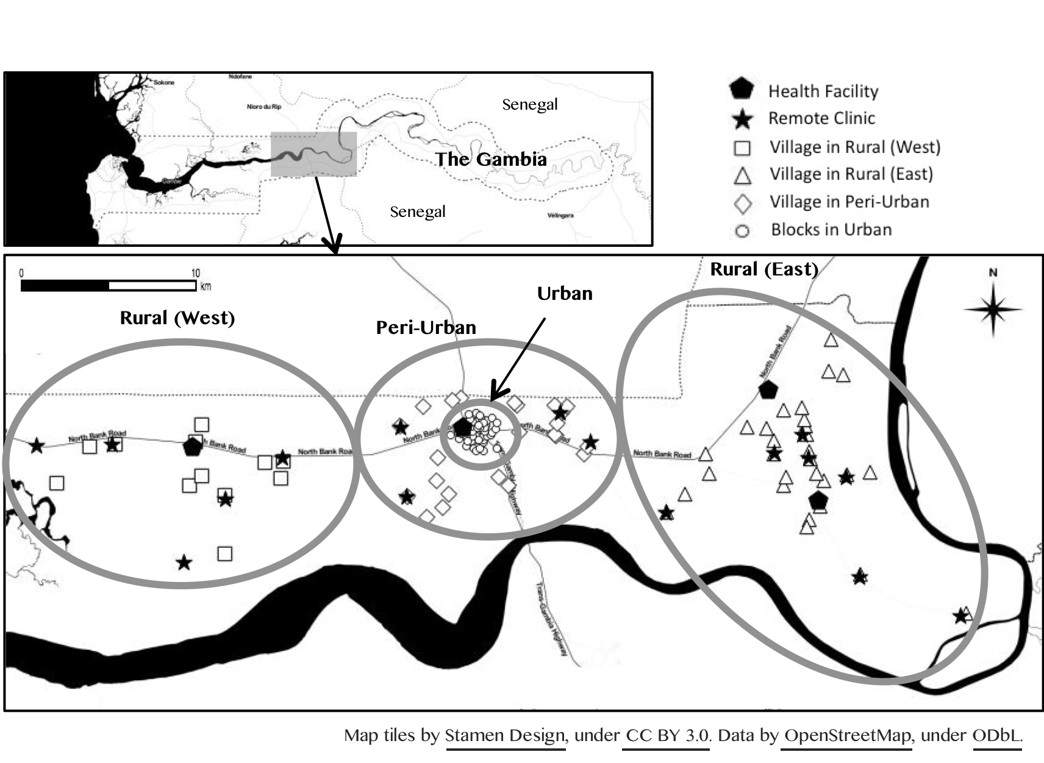
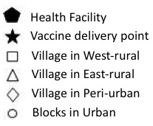
Figure 1. Map of Farafenni Health and Demographic Surveillance System

Slide 2
Figure 2. Vaccine coverage within 1 year of age in FHDSS from 2004 to 2014

