Slide 1
Aid effectiveness principles for scale-up of innovations to improve maternal and newborn survival in Northeast Nigeria, Ethiopia and Uttar Pradesh State, in India
Deepthi Wickremasinghe, Neil Spicer, Meenakshi Gautham, Nasir Umar, Della Berhanu, Joanna Schellenberg,
London School of Hygiene & Tropical Medicine
Improving health worldwide
@LSHTM_IDEAS

Slide 2
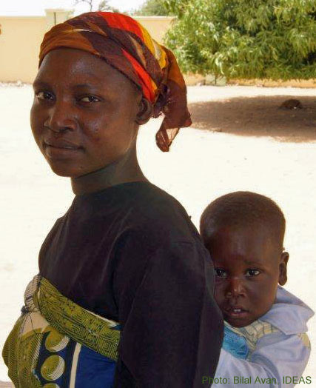
Outline
Background to the study
About the study
Emergent themes relating to principles of aid effectiveness
How those principles affect scale-up
Enabling and challenging factors they present in three geographical settings
Key messages

Slide 3
Why aid effectiveness and scale-up?
©: Paolo Patruno Photography

Slide 4
About our study
Aim: To understand how to catalyse scale-up of externally funded MNH care innovations and identify factors enabling or inhibiting their scale-up.
Methods:
150 in-depth interviews
2012-2013
Purposively selected stakeholders
Uttar Pradesh, India
Northeast Nigeria
Ethiopia

Slide 5
Definitions
Scale-up:
Increasing the geographical reach of externally funded maternal and newborn health innovations to benefit a greater number of people beyond the initial programme districts
Innovation:
A community-based approach to enhancing health

Slide 6
International agreements
Global Partnership for
Effective Development Cooperation (from 2011)
Paris Declaration of Aid Effectiveness(2005)
IHP+ (from 2007)
Accra Agenda for Action (2008)
Busan Partnership for Effective Cooperation (2011)

Slide 7
Aid effectiveness principles that emerged from analysis
Country ownership
Alignment
Harmonisation
Transparency and accountability
Aid predictability
Civil society engagement and participation

Slide 8
Country ownership:
A recipient country’s government leads on developing policies and strategies for health and development.
‘Ultimately the owner of scale-up is government’

Slide 9
Alignment:
Ensuring that the focus of aid fits with recipient countries’ national health priorities, policy frameworks and targets.
‘It’s much easier to introduce an innovation within government systems than from outside, if you want it to be taken up’

Slide 10
Harmonisation:
Coordinating donors and implementers in planning and implementing health programmes, and using common systems and processes.
‘Donor coordination is key to any scale-up’

Slide 11
Transparency and accountability:
Helps to build trust between donors, government and implementers, and effective information sharing can foster scale-up.
‘It’s no longer business as usual. People are asking questions, people want to be informed’

Slide 12
Aid predictability:
A degree of financial stability, helps governments make long-term health spending commitments, such as financing the scale-up of innovations introduced by externally funded implementers.
‘By the time the programme starts showing results, it is finishing’

Slide 13
Civil society engagement and participation:
Recognising the contribution civil society can make, and encouraging partnership working on decisions for health priorities and how to meet them.
‘Civil society is now viewed as a force of change’

Slide 14
Summary: comparison across settings
 | Ethiopia | NE Nigeria | Uttar Pradesh
Country ownership
Alignment
Harmonisation
Transparency & accountability
Aid predictability
Civil society engagement & participation
Credit: Tick and Cross by Thomas Le Bas for the Noun Project

Slide 15
Key messages
Donors, implementers and governments need to change how they work if they are to realise the aid effectiveness principles and this will take time
Embracing aid effectiveness more strongly, would enhance prospects for scale-up, helping to implement improvements and innovations in health services and systems

Slide 16
With thanks to our colleagues at JaRco Consulting, Health Hub, and Sambodhi, who helped with data collection
IDEAS (Informed Decisions for Actions to improve maternal and newborn health)
Website: ideas.lshtm.ac.uk
Newsletter sign up: bit.ly/ideas-newsletter
Twitter: @LSHTM_IDEAS
Photo: Lindsay Mangham-Jeffries

